Slide 1
LLRW Clive Facility
2016 Disposal Update presented by Dan Shrum
LL Forum, Park City, UT (April 13, 2016)

Slide 2
Safety Topic
Hearing Conservation
John Christian
President, Logistics, Processing and Disposal

Slide 3
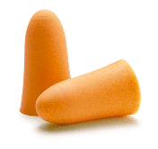
Ear Plugs
Formable
Custom-molded
Must fit tightly in ear canal
Hands must be clean
Must be checked and readjusted
Also they can be purchased in a variety of colors

Slide 4
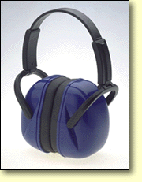
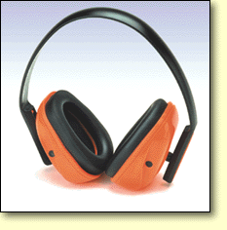
Ear Muffs
Must seal around ear
Hair must be pushed aside
Glasses may interfere
Use with plugs if over 105 dBA

Slide 5

Decibel (Loudness) Comparison Chart
Normal Conversation 3’ 60 – 65 dB
Telephone Dial Tone 80 dB
City Traffic (inside car) 85 dB
Screaming Child 90 dB
Hand Drill 98 dB
Lawn Mower 3’ 107 dB
Snowmobile, Motorcycle 100 dB
Power Saw 3’ 110 dB
Jet Engine 140 dB
12 Gauge Shotgun 165 dB
(90 dB > Level at which sustained exposure may result in hearing loss)

Slide 6
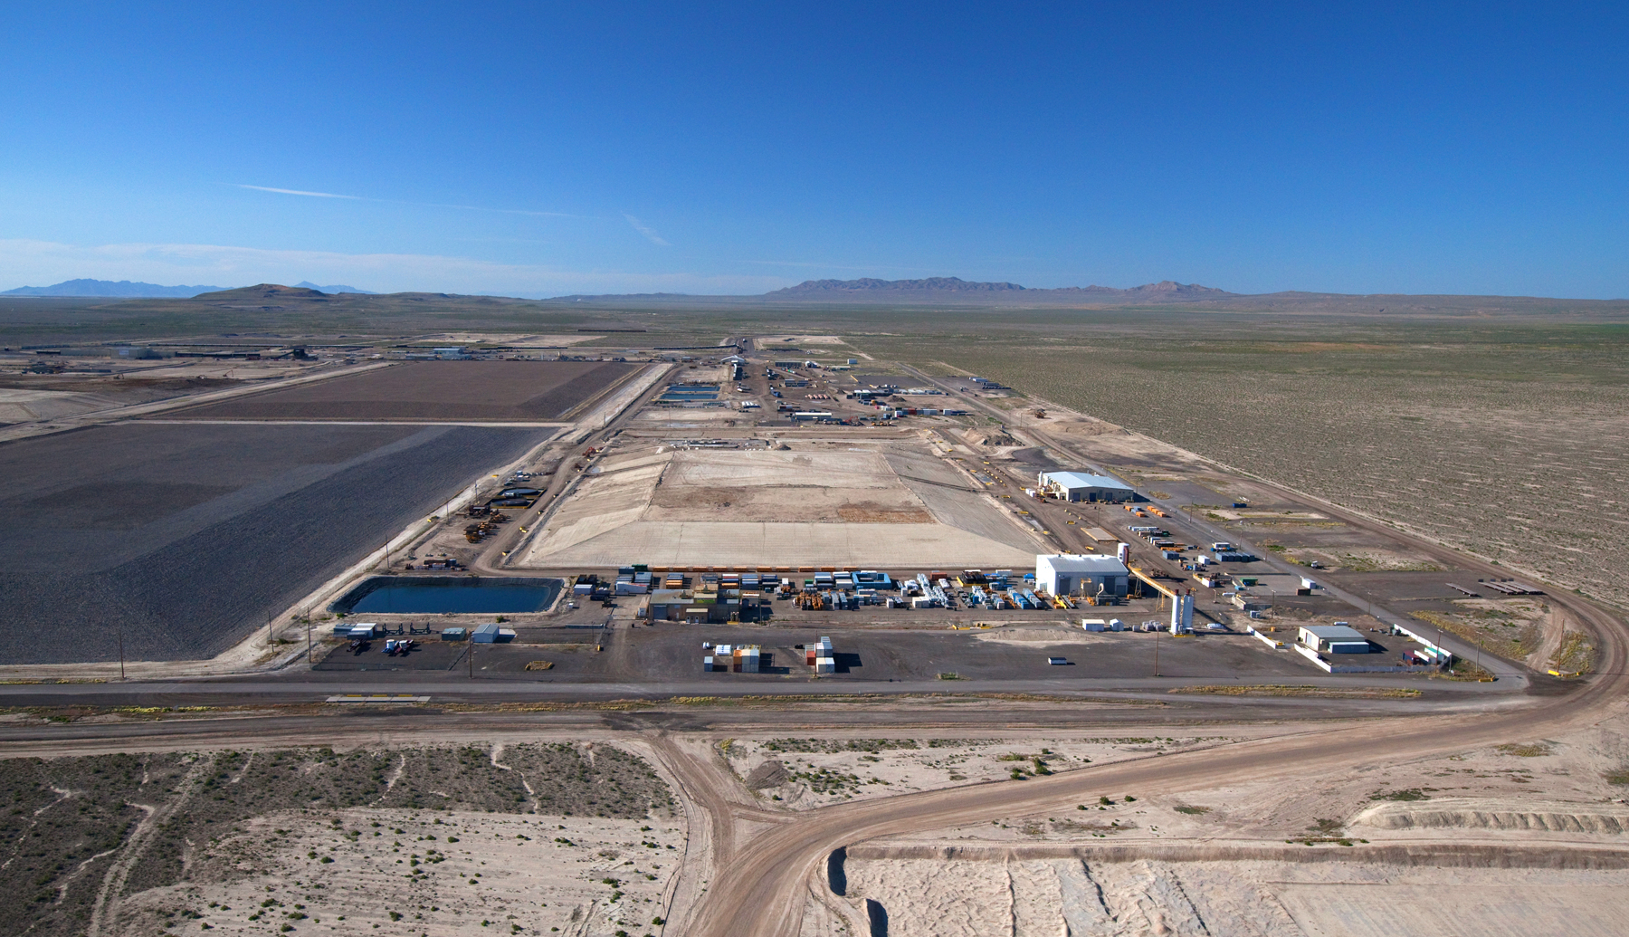
Clive Disposal Facility
World’s Largest Commercial Radioactive Waste Disposal Facility

Slide 7
Corporate Values
We always put Safety first
We build Trust by
  always telling the truth
  making our Customer’s success our success
  being the best in the World at what we do
  and delivering results
We care deeply about our Employees and want them to be happy and successful
We listen to our Internal and External Stakeholders and Partners

Slide 8
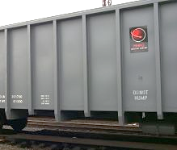
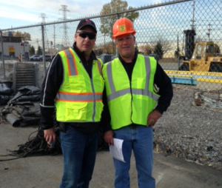
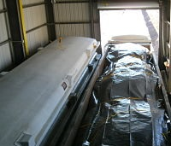
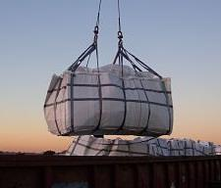
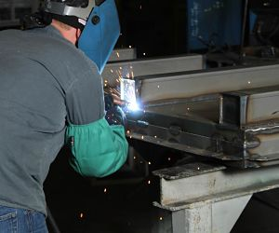
Safety
Industrial Safety
  Total Case Incident Rate = 0 since 2013 (below national average of 4.9)
  Above 10 days between incidents
  1,522,997 work hours since last Lost Workday case (November 2010)
  478,236 work hours since last OSHA Recordable Injury (October 2013)
  2010 through 2015 Annual NSC Awards for Safety
Radiation Safety
  ALARA - Average radiation worker individual TEDE 32.5 mrem/year
  Highest general public fence-line CEDE 0.40 mrem/year
  Highest general public effluent exposure dose 0.07 mrem/year

Slide 9
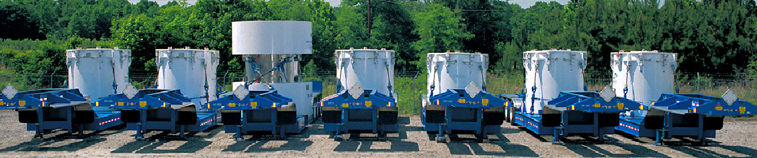
Proven Experience
Over 28 years of proven experience treating and disposing of radioactive waste
Unique bulk and containerized waste facilities
  Radioactive Material Licenses (LLRW & 11e(2))
  RCRA Permit (treatment & disposal of MW)
  TSCA Permit (PCB waste streams)
  SNM Exemption (concentration-based limits)
Over 11 miles of onsite rail for efficient and cost-effective waste handling
Long-term federal and commercial contracts

Slide 10



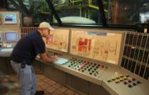
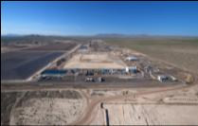
Logistics, Processing, & Disposal
Logistics
  All aspects of complex planning and transportation
  Dedicated fleet of tractors, trailers, railcars, and containers
Processing
  Multiple processing facilities in Canada, South Carolina, Utah, and Tennessee
  Diverse capabilities for handling, treating, and processing radioactive materials
Disposal
  Largest commercial radioactive waste disposal facility for Class A LLRW in the U.S.
  Operate the LLRW disposal facility in Barnwell, SC to dispose of Class A, B, and C LLRW from Atlantic Compact states

Slide 11
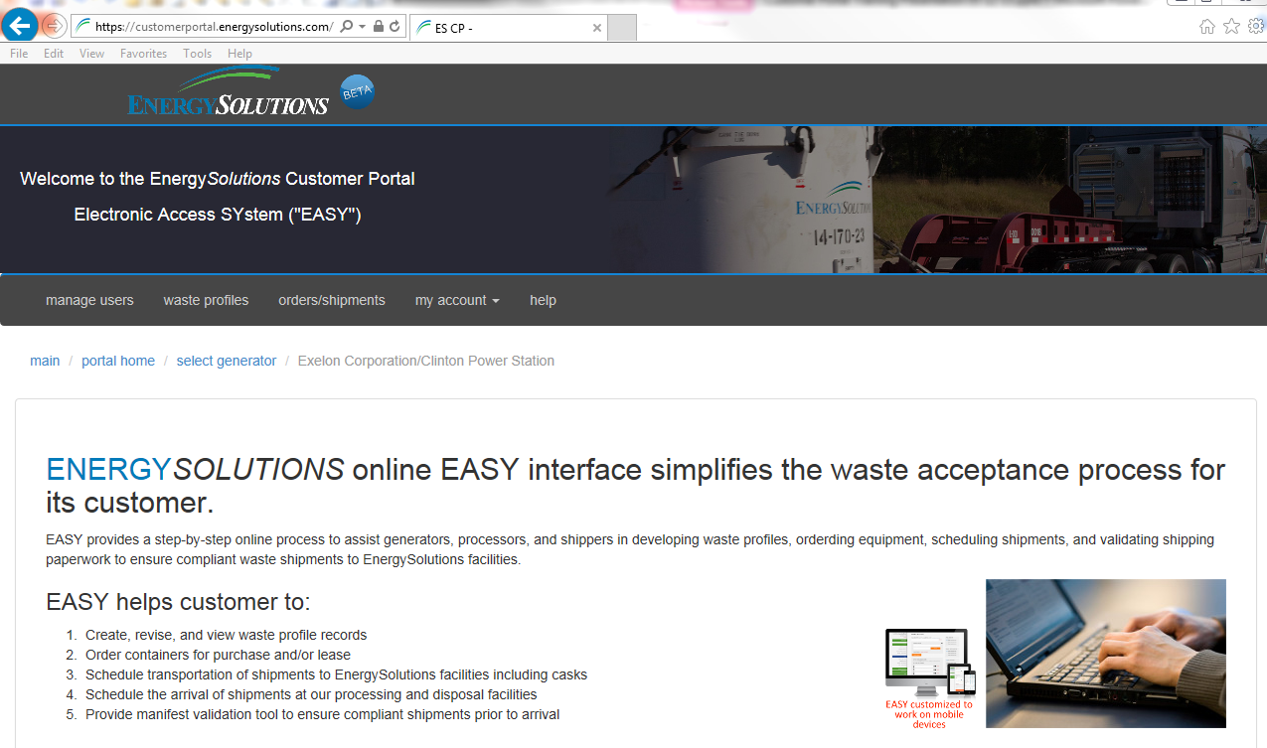
Customer Portal

Slide 12






Customer Portal
Create, revise, and view waste profile records online
Order containers for delivery
Schedule transportation of shipments to EnergySolutions facilities
Schedule arrival of shipments at our processing and disposal facilities
Validate Uniform LLRW manifest to ensure compliant shipments prior to arrival

Slide 13
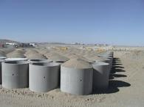
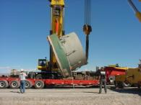
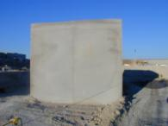
Treatment and Disposal Services
Bulk Waste Disposal
Containerized Waste Facility
Large Components
Mixed Waste Treatment
  Macroencapsulation
  Stabilization
  Liquid Solidification (LLRW and MW)
  Mercury amalgamation
  Thermal Desorption
Disposal of PCB waste

Slide 14
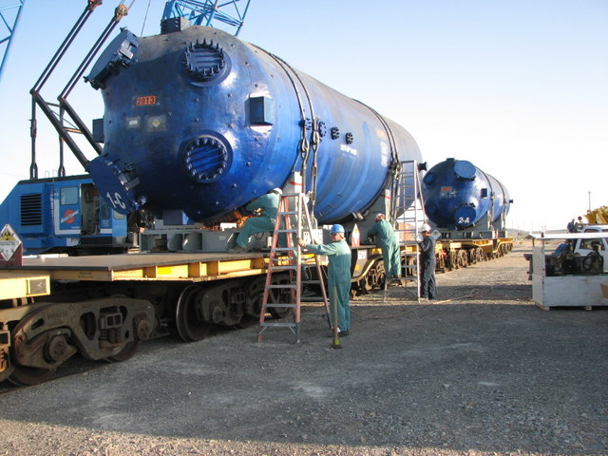
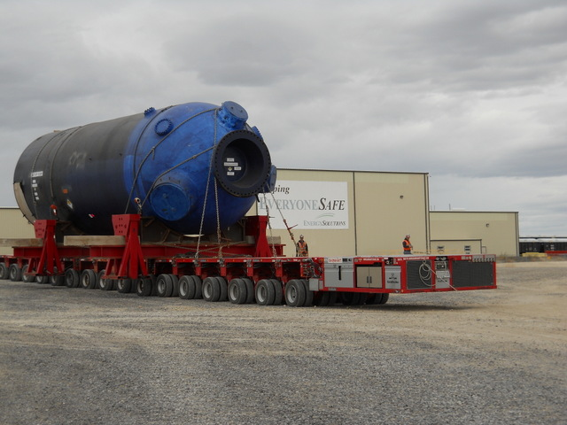
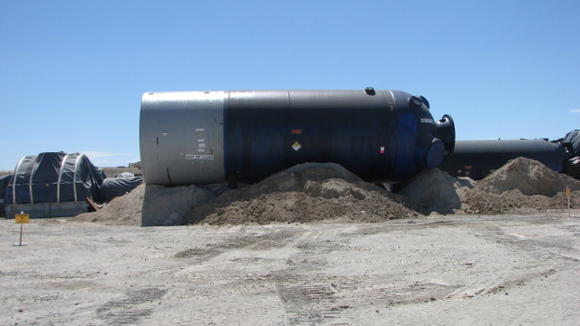
Large Component Disposal

Slide 15
Liquid Verification of Resins
Resins that may not meet the one percent free standing liquid criteria may now be shipped directly to Clive for liquid verification
  Resins must be grossly dewatered
  Contact dose rates must be less than 10 R/hr
  Liners must have passive vent systems to address potential off-gassing
  Resin in steel liners require written authorization prior to shipment
  Any free liquid is drained to ensure compliance with disposal site criteria

Slide 16
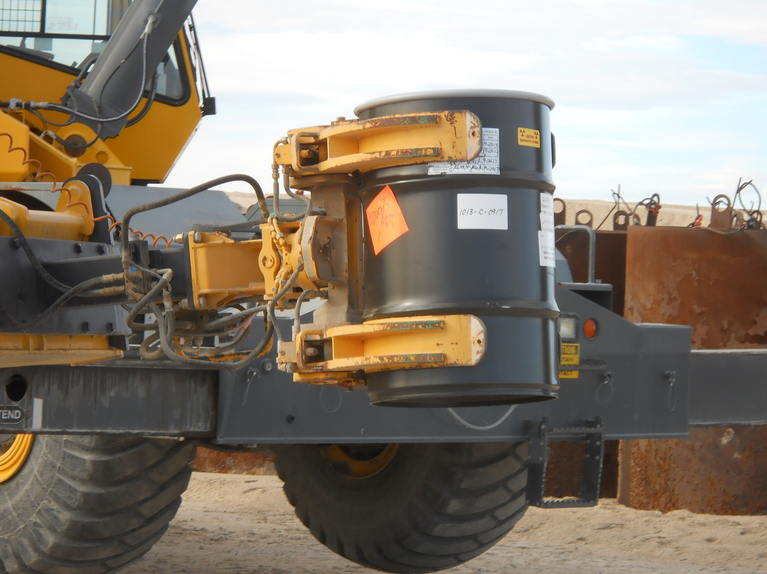
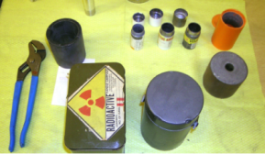
Sealed Sources
Challenges
  historical lack of disposal pathway
  inherent global threat from misuse
Conference of Radiation Control Program Director’s Source Collection and Threat Reduction Program (SCATR)
Utah granted license variance for disposal of Class A sealed sources
  Received and managed 41,190 sealed sources between 2013 and 2015.
Permanent License amendment has been requested and is part of the renewal

Slide 17
Clive’s Disposal Available Capacity
Proposed Federal
Cell
Class A West
(4,282,187 yd³)
11e.(2)
(3,435,734 yd³)
LARW
(closed)
VITRO
(closed)
Mixed Waste
(354,110 yd³)
North

Slide 18
Disposal Volume History

Slide 19
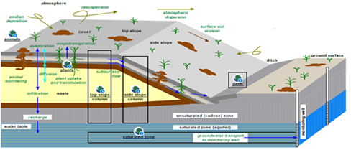
Depleted Uranium Authorization
Utah Moratorium passed June 1, 2010
  May not receive or dispose of significant quantities of concentrated DU until PA approved
  PA, revision 0 submitted June 2011
  PA, revision 4 submitted November 2015
Regulatory review underway
Decision projected for Q1 2017

Slide 20
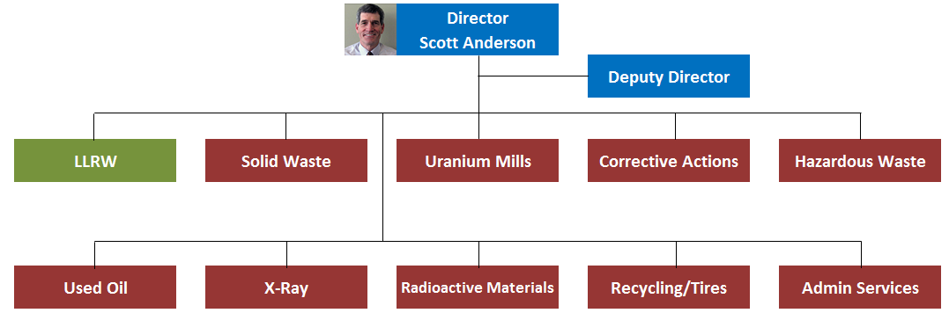
Regulatory Consolidation
Utah Division of Waste Management and Radiation Control (DWMRC)
Utah Division of Radiation Control consolidated with several other divisions under the Department of Environmental Quality
Scott Anderson (Director of DSHW) became new Director of the DWMRC effective July 1, 2015
More efficient and better use of resources across the division

Slide 21
Thank You

