Slide 1
Department of Energy Office of Waste Management Update
Doug Tonkay
Director, Office of Disposal Operations
Low-Level Radioactive Waste Forum, Inc.
October 22, 2015

Slide 2
Presentation Topics
Update on Waste Isolation Pilot Plant (WIPP)
Update on low-level radioactive waste (LLW) and mixed LLW (MLLW) waste disposal at DOE facilities
Waste management forecasts
Manifest Information Management System (MIMS) update
Other departmental highlights and activities

Slide 3
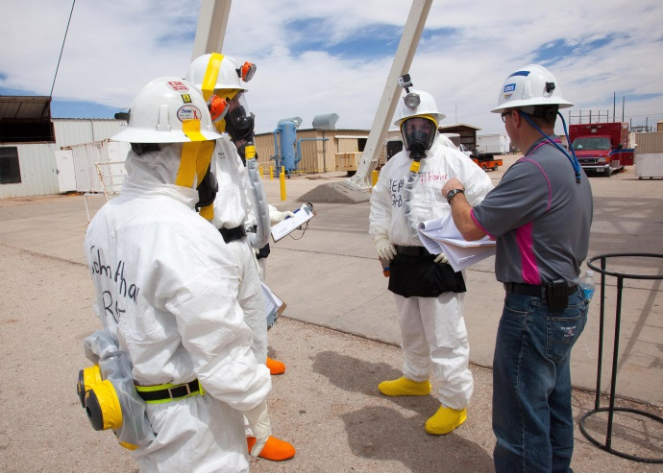
WIPP: Key Recovery Steps
Documented Safety Analysis revisions
Safety Management Program revitalization
Underground restoration
Re-establish degraded equipment
Fire protection
Maintenance and ground control
Radiological risk mitigation
Soot cleaning of electrical panels
Expedited mine stability
Initial Panel 6 and Panel 7, Room 7 closure
Interim ventilation and supplemental ventilation modifications
Notes:
Background on Incidents:
Fire:
Occurred shortly after 11 a.m. on Feb. 5.
86 people in the mine, all exited safely; 6 personnel were transported to the Carlsbad Medical Center for smoke inhalation were released the same day. 7 were treated on-site.
WIPP’s Emergency Operations Center was activated.
An underground vehicle used to transport salt was on fire in the underground.
All operations at the repository ceased at that time.
Radiological Incident:
Shortly before midnight on Feb. 14 a continuous air monitor detected a radiological release in the underground.
HEPA filters on-site immediately engaged, thereby minimized releases to the environment.
Monitors on site detected slightly elevated levels of airborne radioactive concentrations, which is consistent with the type of radiation TRU waste has when being placed in the repository.
After recognizing that it wasn’t a radon event, additional precautions were taken to shelter workers.
Concentrations were then and remain today well below a level of public or environmental hazard.
Samples from around the site have been taken and results are confirming these findings.
22 workers on site Feb. 14 and Feb. 15 were exposed to extremely low levels of americium and plutonium these employees are unlikely to experience any health effects as a result .

Slide 4
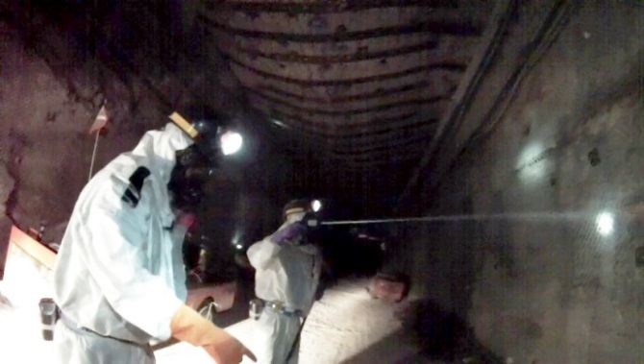
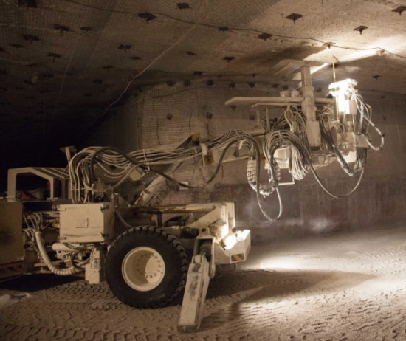
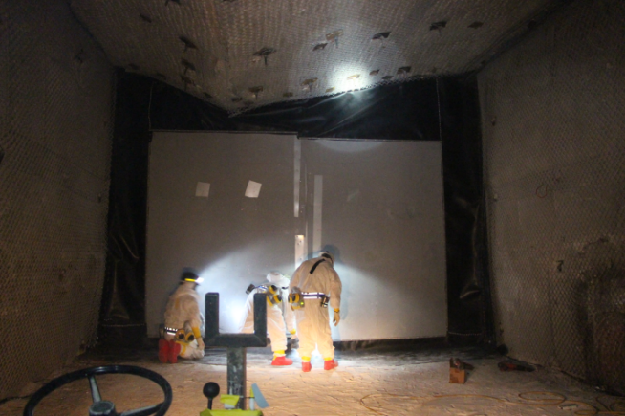
WIPP: Areas of Significant Progress
Ground control – 85% of catch-up bolting complete
Radiological risk reduction – over 65% of underground released as controlled area
Soot cleaning – 98% complete
Zone recovery (Zones 1-7) – complete
Initial closure of Panel 6 and Panel 7, Room 7 – complete
Revision of DSA in progress
Interim Ventilation System (IVS) – repairs completed, proceeding with installation
Supplemental Ventilation System – complete, waiting for IVS (must be operated in tandem)
Hybrid diesel electric bolter in operation – training ongoing
Approval of Integrated Performance Measurement Baseline – in progress

Slide 5
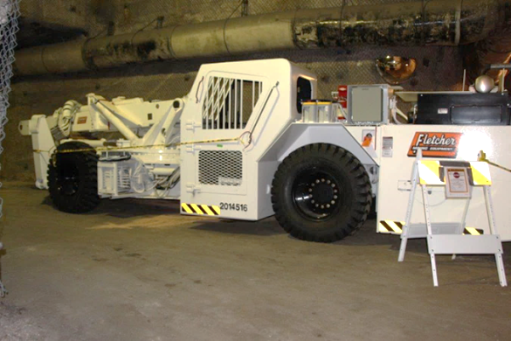
WIPP: AIB Reports and Corrective Action Plans
CBFO/NWP Corrective Action Plans (CAPs) for judgments of need (JON) from Accident Investigation Board (AIB) reports on haul truck fire and Phase I radiological event approved in February 2015 – now in implementation
AIB Report for Radiological Release Event, Phase II, issued April 2015
Phase II focused on determining direct cause of release
Phase II CAPs approved in early September 2015 – now in implementation

Slide 6
TRU Waste Generator Impacts
Prioritization of shipments
Premature at this stage of recovery to predict and allocate rate of TRU waste shipments to WIPP
Initial focus will be on emplacement of wastes generated during recovery activities and emplacement of wastes currently stored in WIPP surface facilities (wastes were received but not emplaced prior to the events)
In determining rate of shipments among sites, DOE will consider numerous technical and programmatic factors
WIPP transportation and waste acceptance capabilities
Generator site compliance commitments
Storage capacities
Construction of additional surface storage at WIPP is one option under consideration

Slide 7
WIPP Way Ahead
Develop new PMB based on current schedule/cost impacts
Complete installation and testing of interim and supplemental ventilation
Complete Documented Safety Analysis, Contractor Management Assessments, Operational Readiness Reviews
Resume waste emplacement

Slide 8
DOE’s Unique Waste Management Mission
Authority and responsibility for management of all DOE-generated waste under authority of the Atomic Energy Act, as amended
DOE has unique waste streams because of its historic and present missions
Clear distinction between DOE and non-DOE waste in the Low-Level Waste Policy Amendments Act
State and regional disposal compacts responsible for disposal of non-DOE and non-naval decommissioning LLW
DOE does not accept LLW/MLLW from non-DOE generators unless there is documented DOE nexus or national security rationale in accordance with eligibility criteria

Slide 9
DOE LLW/MLLW Management Policy
DOE Order 435.1, Radioactive Waste Management, with associated guidance, provides policy and requirements for DOE Waste Management
Current LLW disposal policy:
Dispose of radioactive waste at site where generated, if available
If disposal is not available on-site, then off-site at another DOE facility
Disposal at a non-DOE facility when compliant and protective of health and safety and in the best interest of the government
Exemption documentation includes annual facility reviews, life-cycle cost analysis, etc.
Historically, DOE on-site (~90% by volume), DOE off-site (~5% by volume), and commercial disposal (~5% by volume)
DOE generally does not utilize State compact facilities for disposal of LLW/MLLW

Slide 10
Complex-wide LLW/MLLW Disposal
by Location

Slide 11
FY15 NNSS Disposal Volumes
Generator Site |  | FY15 Actual* (ft3) | FY15 Actuals + Remaining Forecast for Sep 2015 (ft3)
Portsmouth GDP (OH) |  | 543,827 | 627,918
Oak Ridge Reservation (TN) |  | 126,540 | 164,507
Oak Ridge NNSA/Y-12 (TN) |  | 118,422 | 130,672
Los Alamos National Lab (NM) |  | 33,282 | 52,861
Idaho Site (ID) |  | 125,916 | 138,122
Livermore Nat'l Lab (CA) |  | 45,684 | 48,572
Paducah GDP (KY) |  | 5,465 | 5,465
NNSA/Nuclear Fuel Services (TN) |  | 39,506 | 47,001
Onsite NNSS (NV) |  | 13,348 | 13,348
Savannah River (SC) |  | 535 | 1,075
Berkeley |  | 0 | 0
West Valley (NY) |  | 9,078 | 9,078
All other sites |  | 57,281 | 66,245
Total |  | 1,118,884 | 1,304,864
Forecasting supports operational planning
Updated quarterly
* Actual volumes thru 8/23/15

Slide 12
DOE LLW/MLLW Forecasts
EM updates its DOE-wide life-cycle LLW/MLLW forecasts annually in coordination with other Program Offices – NNSA, SC, NE, and Naval Reactors
Information publicly available through Waste Information Management System (WIMS) maintained by Florida International University

Slide 13
Manifest Information Management System
DOE maintains Manifest Information Management System (MIMS) under requirement of the LLWPAA (since 1986)
System updated to meet current DOE IT platform requirements
Update ongoing to add search capability by “generator identification number”
Hosted at: http://mims.doe.gov/
Provides LLW disposal manifest volume and activity information with generator class as provided by disposal site (does not identify specific generator)
Currently, system has records from operating disposal sites at Barnwell, SC; Clive, UT; Richland, WA; Andrews, TX; closed Beatty site
Barnwell (Chem-Nuclear): 1986-2014
Clive (EnergySolutions): 1992-2014
Richland (US Ecology): 1986-2014
Andrews (WCS): 2012-2014

Slide 14
Current MIMS Status
New user-defined reports now available with both volume and activity breakout by classes (replacing old standard reports)
Ongoing collection of 2015 data
Continuing to make improvements based on user feedback, such as capability to search by generator
Industry has requested NRC allow waste generators to cite MIMS data for solid radioactive waste disposal in lieu of creating redundant reports to meet annual Radioactive Effluent report requirements (RG 1.21)

Slide 15
Other Waste Management Updates
Final GTCC EIS undergoing internal review; expected publication next quarter
EM currently working to resolve comments on DOE Order 435.1
DOE anticipates DOE-wide review early next year
EM anticipates public comment and formal REVCOM review next year
National Environmental Policy Act documentation initiated for location(s) to dispose of depleted uranium oxide conversion products generated from DOE's inventory of depleted uranium hexafluoride
Maintenance of corporate programs to integrate waste disposition efforts (such as LLW and TRU Corporate Boards)
Recurring forums for discussion and problem-solving with contractors, i.e. EFCOG Waste Management Working Group

Slide 16
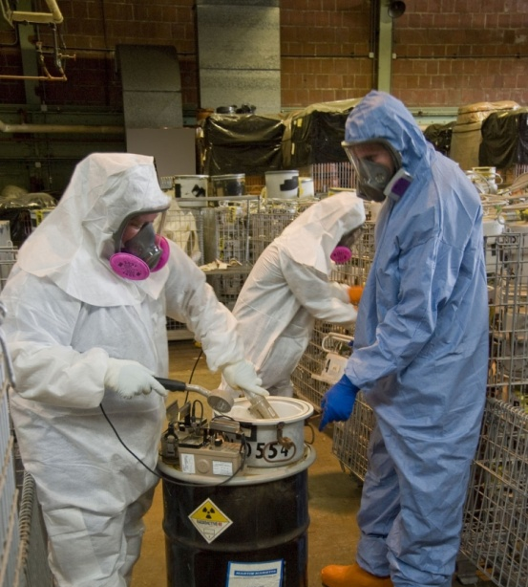
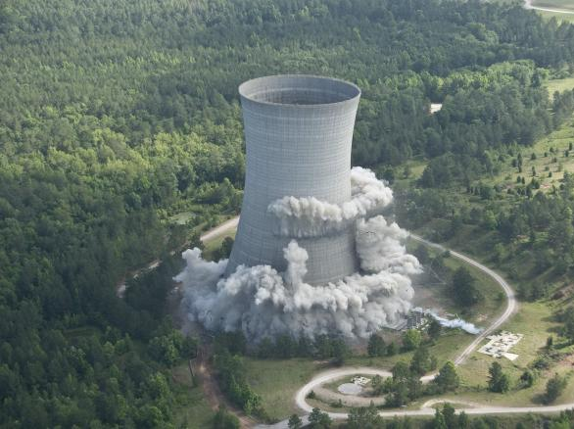
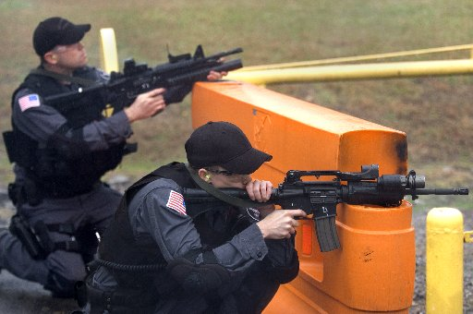
Questions
PACKAGE
BUILD
&
TREAT
EXCAVATE
TRANSPORT
DEMOLISH
SAFEGUARD
SAFEGUARD

