Slide 1
EPRI Comments Re: NRC-2015-0003 “Low-Level Radioactive Waste Disposal”
Presented by Karen Kim, Sr. Technical Lead, EPRI
LOW-LEVEL RADIOACTIVE WASTE FORUM, INC.
Fall 2015 Meeting
Chicago, Illinois
October 22-23, 2015

Slide 2
Previous Recommendations to NRC
Summarized in EPRI Report 1021098, “Options for Improved Low Level Waste Disposal Using 10CFR61.58”
1,000 years LLRW from normal NPP operations poses little risk to the public.
The concentration limits in 10 CFR 61.55 are based upon ICRP 2 dose conversion factors. Updated dose conversion factors are available.
The concentration limits in 10 CFR 61.55 were based on a set of generic, conservative site assessment models. These limits are overly limiting for current and developing LLRW disposal sites.
All EPRI’s previous recommendations have been incorporated or addressed in the new proposed rule.

Slide 3
Comments to NRC Re: March 26, 2015 Proposed Rule
Protective Assurance Period
Institutional Control Period and Inadvertent Intrusion
Blended Waste Described as Unanalyzed Waste Stream
Requirement for Site Closure Site-Specific Technical Analysis
Generator’s Certification Statement
Clarification Regarding Average Concentrations
Dose Level and Effective Dose Equivalent
Structural Stability and the Proposed 61.58
Introduction of the Term “Waste Acceptance Criteria” for Site Specific Technical Analyses

Slide 4
Comments to NRC Re: March 26, 2015 Proposed Rule
Protective Assurance Period
Long time frames of analysis (greater than 1,000 years for the protective assurance period) have high levels of uncertainty.
There are few points of comparison with past human activity to benchmark such analyses against.
The need for analysis beyond 1,000 years should be more clearly limited to specific waste streams that are dominated by long-lived radionuclides.

Slide 5
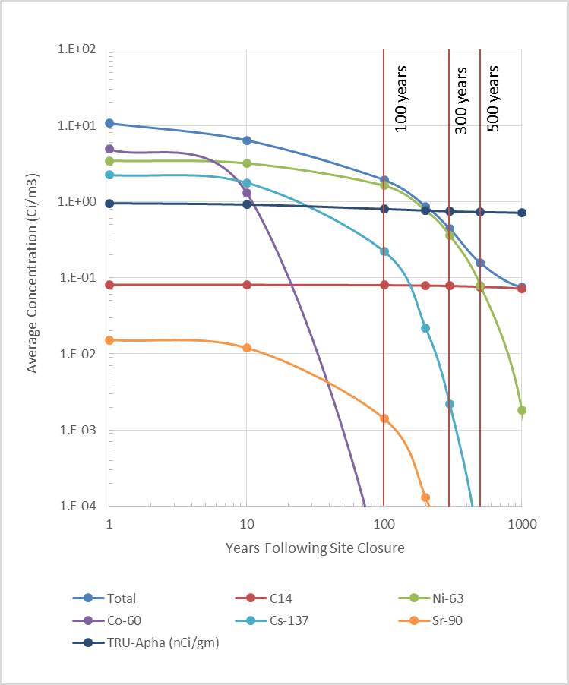
Comments to NRC Re: March 26, 2015 Proposed Rule
Institutional Control Period and Inadvertent Intrusion
The scientific or technical basis for the 100-year active institutional control period and timing of inadvertent intrusion is unclear.
An active institutional control period of 300 years:
Is more probable
Provides a more accurate assessment of the risk to an inadvertent intruder
Would better align with U.S. and international practices

Slide 6
Comments to NRC Re: March 26, 2015 Proposed Rule
Blended Waste Described as Unanalyzed Waste Stream
The NRC position that “the blending of different classes of LLRW could also result in LLRW streams with concentrations that are inconsistent with the assumptions used to develop tables 1 and 2 of 10 CFR 61.55…”
This position is inconsistent with Revision 1 of the Concentration Averaging and Encapsulation Branch Technical Position (BTP).
EPRI recommends that references to blended waste streams as not being analyzed be removed.

Slide 7
Comments to NRC Re: March 26, 2015 Proposed Rule
Requirement for Site Closure Site-Specific Technical Analysis
If all of the waste that was disposed of at a particular site was analyzed in the initial site-specific technical analysis the requirement to submit a second analysis at closure should be unnecessary.
An alternative to the proposed analysis requirement would be to allow sites to analyze for “new” waste streams during operation prior to accepting them for disposal.
This option provides greater assurance of compliance and eliminates the potential for disposal of waste streams that may not meet performance objectives.

Slide 8
Comments to NRC Re: March 26, 2015 Proposed Rule
Generator’s Certification Statement
The words “disposal” and “classified” should be removed from the certification statements in NUREG/BR-0204, Form 540 and 10 CFR Part 20 Appendix G.
Clarification Regarding Average Concentrations
Provide clarification that “average concentrations” refers to disposal site concentration in 10 CRF 61.13 (e).

Slide 9
Comments to NRC Re: March 26, 2015 Proposed Rule
Dose Level and Effective Dose Equivalent
The dose values should be stated as effective dose equivalents (EDE) to be consistent with latest dose assessment science and terminology.
Dose values should be updated to be consistent with ICRP 81 and ICRP 103 recommendations.
Structural Stability and the Proposed 61.58
The proposed 61.58 (a) (2) should be reworded to specify containers and/or conditioning required by the disposal site as a component of stability.

Slide 10
Comments to NRC Re: March 26, 2015 Proposed Rule
Introduction of the Term “Waste Acceptance Criteria” for Site Specific Technical Analyses
The term “waste acceptance criteria” has commonly been used in the LLRW industry for many years.
It would be helpful to add clarity to the regulations and guidance to refer to use alternative terms for what has been introduced as “waste acceptance criteria” in the proposed rule.

Slide 11
Related EPRI Research & Closing Thoughts
The results of EPRI research related to this topic have been published in several publicly available technical reports:
An Evaluation of Alternative Classification Methods for Routine Low Level Waste from the Nuclear Power Industry. EPRI, Palo Alto, CA, 2007, 1016120
Proposed Modifications to the NRC Branch Technical Position on Concentration Averaging and Encapsulation (BTP): Technical Bases and Consequence Analysis. EPRI, Palo Alto, CA, 2008, 1016761
Options for Improved Low Level Waste Disposal Using 10 CFR 61.58. EPRI, Palo Alto, CA, 2010. 1021098.
Closing Thought: The Waste Classification Tables should be removed or revised.

Slide 12
Questions or Comments?

