Slide 1

LOW LEVEL RADIOACTIVE WASTE
FORUM--FALL 2014 MEETING
CRCPD E-42 TASK FORCE
REVIEW OF THE TENORM ISSUES OF THE OIL & GAS
INDUSTRY
JARED W. THOMPSON
CHAIR, E-42 TASK FORCE
October 30, 2014 Denver, Colorado

Slide 2
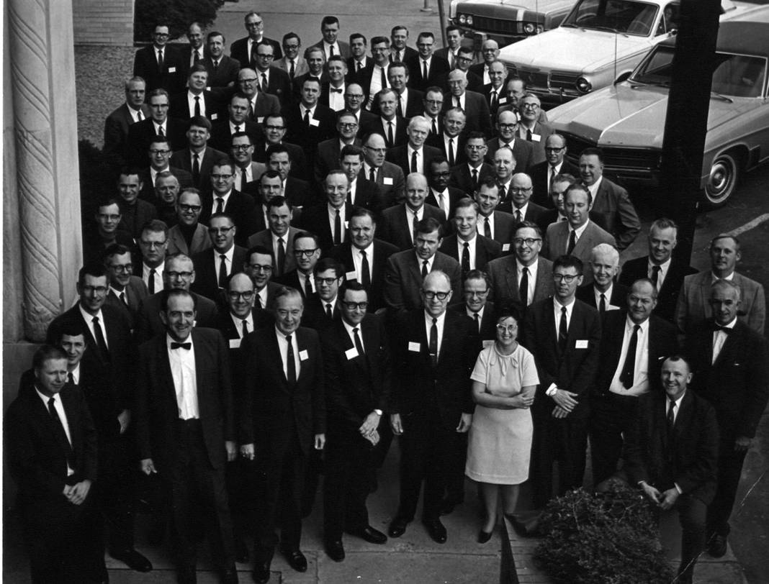
Conference of Radiation
Control Program Directors, Inc. (CRCPD)
A Partnership Dedicated to Radiation Protection

Slide 3
Mission
To promote consistency in addressing and resolving radiation protection issues.
To encourage high standards of quality in radiation protection programs.
To provide leadership in radiation safety and education.

Slide 4
PURPOSE
To provide a common forum for the exchange of information among State and local radiation control programs.
To provide a mechanism for States to communicate with the federal government on radiation protection issues.

Slide 5
ORGANIZATION
Partnerships with Experts from Numerous Federal Agencies
Centers for Disease Control and Prevention
Department of Energy/National Nuclear Security Administration
Department of Homeland Security/Federal Emergency Management Agency

Slide 6

ORGANIZATION
Partnerships with Experts from Numerous Federal Agencies
Department of Transportation
Environmental Protection Agency
Food and Drug Administration – Center for Devices and Radiological Health
Nuclear Regulatory Commission

Slide 7

CONTACT INFORMATION
Web-Site:
www.crcpd.org
Address:
CRCPD
1030 Burlington Lane, Suite 4B
Frankfort, Kentucky 40601
Telephone Number:
(502) 227-4543

Slide 8


DISCLAIMER
The views and opinions shared in this presentation do not represent the opinions of the State of Arkansas or the Arkansas Department of Health.

Slide 9
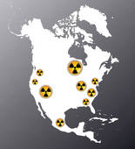
DISCLAIMER
The views and opinions shared in this presentation do not represent the opinions of the Conference of Radiation Control Program Director Members or the CRCPD Executive Board.

Slide 10
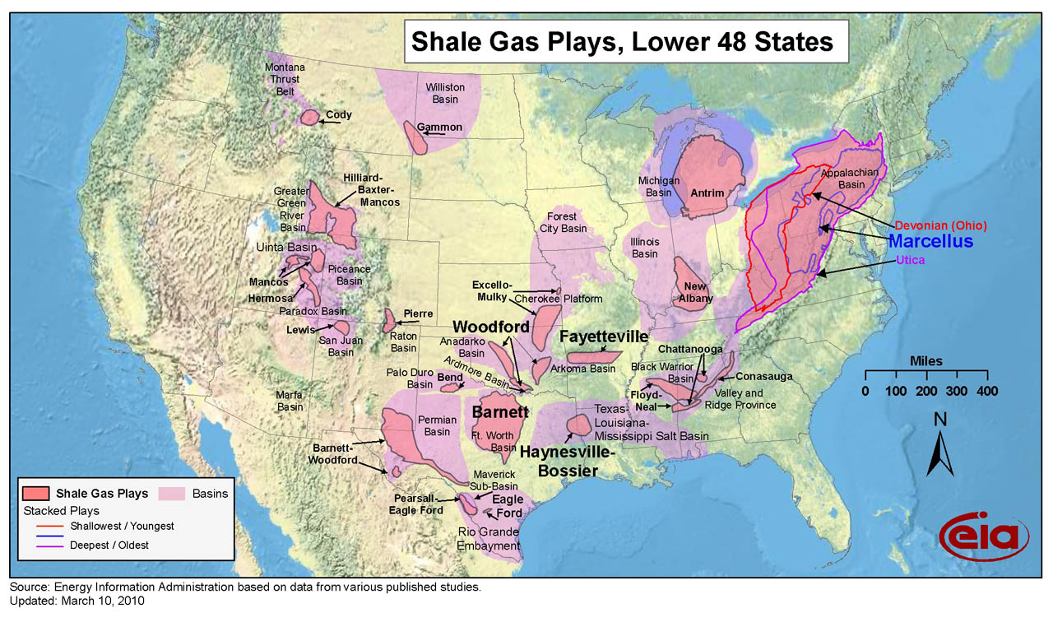
SHALE FORMATIONS IN USA
Assess and evaluate TENORM Worker Awareness Training and general Public Awareness Information.

Slide 11
CRCPD E-42 TASK FORCE
  CRCPD Executive Board formed the E-42 Task Force in May 2012.
  Charge:
    Publish a “White Paper” that examines and reviews the TENORM radiological, environmental, regulatory and health and safety issues observed since the publication of the CRCPD E-4 report (1994) and the E-36 Implementation Guidance (2003).

Slide 12
CRCPD E-42 TASK FORCE
  The “White Paper” will at least summarize the following TENORM issues:
    Provide assessment and propose recommendations for the following:
      TENORM Radiation Exposure Issues- Occupational/ Public exposures included but not limited to regulatory impacts and health and safety.
      TENORM Environmental Impacts from technologies included but not limited to, disposal options for various types of TENORM waste
    Assess and evaluate TENORM Worker Awareness Training and general Public Awareness Information.

Slide 13

ISSUES
Expand/ define the description of the hazards associated with TENORM.
Describe/ update the characterization of the type of TENORM waste associated with the oil and gas industry.
Develop guidance addressing training for personnel working in oil and gas.
Consistency of State TENORM regulations
Describe appropriate radiochemical analytical protocols for demonstrating regulatory compliance.
Discuss and identify trigger levels
    Exposures
    Concentrations (Soil/Water/ Waste)
“Is 5pCi/gram the right number?”

Slide 14
POSSIBLE RECOMMENDATIONS
Revise CRCPD Suggested State Regulations- Part N to become more in line with current oil and gas operations.
Propose a new definition of TENORM in Part N
Propose and develop trigger levels for radiation exposures/ concentrations working in cooperation with the NCRP- More Technical Evaluation of the 5pCi/gram standard
Nationwide consistent and uniform TENORM regulations- Need for Federal oversight

Slide 15
POSSIBLE RECOMMENDATIONS
Investigate the radon emissions and exposures associated with Natural Gas – Is Radon in Natural Gas an exposure pathway?
Implementation of TENORM safety training requirements for field personnel
Implementation of requirements for instructors providing TENORM safety training.
Assess and quantify the extent of Pb-210 and Po-210 contamination in the natural gas industry to evaluate worker protection.

Slide 16

CRCPD E-42 TASK FORCE
  TIMELINE
  White Paper to be completed and submitted to CRCPD Executive Board on December 31, 2014

Slide 17


CRCPD E-42 TASK FORCE
TENORM WORKSHOP
CRCPD is in the process of planning a TENORM Workshop in conjunction with the Annual Meeting in St. Louis, Missouri on
May 18-21,2015.
Tentative date of the Workshop is scheduled for
May 17, 2015.

Slide 18



CRCPD E-42 TASK FORCE
QUESTIONS??
Contact Information:
501-661-2173
jared.thompson@arkansas.gov

