Slide 1
BAKKEN/THREE FORKS CHALLENGES
North Dakota

Slide 2
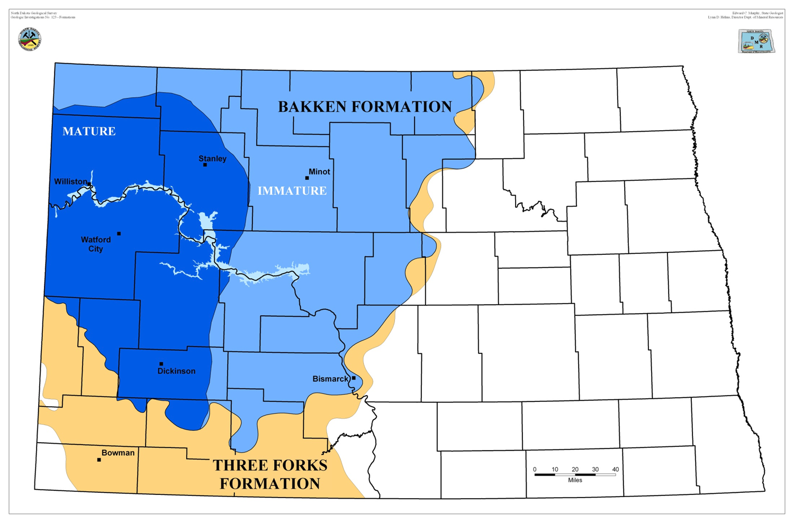

Slide 3
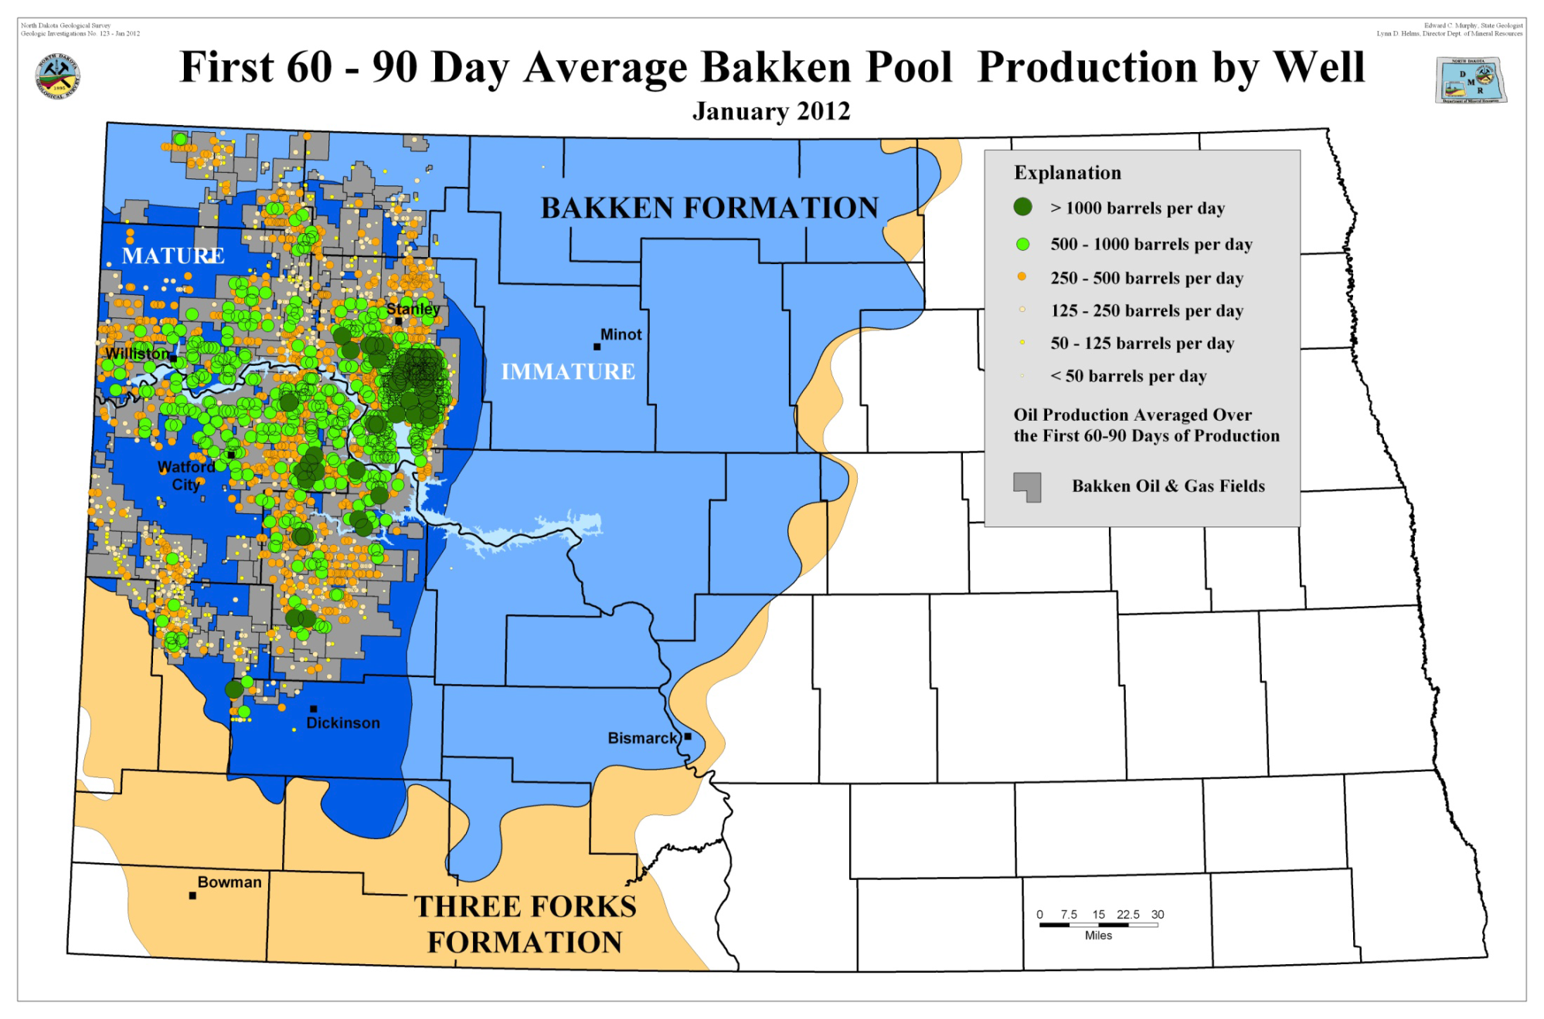

Slide 4
Lower Member 11,000 Feet Down Oil found at all levels on this diagram

Slide 5
How much oil in North Dakota?
2013 Assessment
Oil – 7.4 billion barrels (42 gallons/barrel)
Natural Gas – 6.7 trillion cubic feet
Natural Gas Liquids – 0.53 billion barrels
193 drilling rigs operating capable of 20,000 ft. depth

Slide 6
AS of May, 2014
1,092,617 barrels/day produced
1,253,154 million cubic feet of Natural Gas/day
11,079 producing wells
Estimated that there will be 50,000 – 70,000 producing wells when this is finished.
Estimated to continue for more than 20 years
June rig count 192
Drilling has begun about 125 miles to the southeast of current activity for Natural Gas with one well complete finding gas as expected

Slide 8
Process
Well is drilled to kick-off point where directional drilling takes place.
Horizontal drilling now takes place going out from the vertical well bore for 2 miles or more.

Slide 9
Fracturing the oil bearing formation

Slide 10
Fracturing Process
it.
Well formations are fractured using explosives down hole and very large volumes of water under very high pressures (several million gallons used).
The fracturing process allows the oil which is trapped in the shale to flow to the drill hole.
Water that is used and captured during this process is called flowback and is hauled off site.
This water and water that is produced along with the oil has suspended soil products in it.

Slide 11
Hydraulic Fracturing

Slide 13
WHY FRAC THE ROCK?
• already developed easy oil
oil flows easily without fracking
• Unconventional Reserves
reservoirs are tight
uneconomic to produce w/o fracking
must create a path for oil to flow

Slide 14
Process continued…
Much of the flowback water is reused in the next well, but must be filtered before it can be used again. (This is one of the problems facing North Dakota)
The produced water is taken to a Permitted Salt Water Disposal Well to be pumped down hole at 5,ooo+ feet.
This water must be filtered so the Disposal Well does not get plugged up.
These suspended materials contain Naturally Occuring Radioactive Materials (NORM).

Slide 15
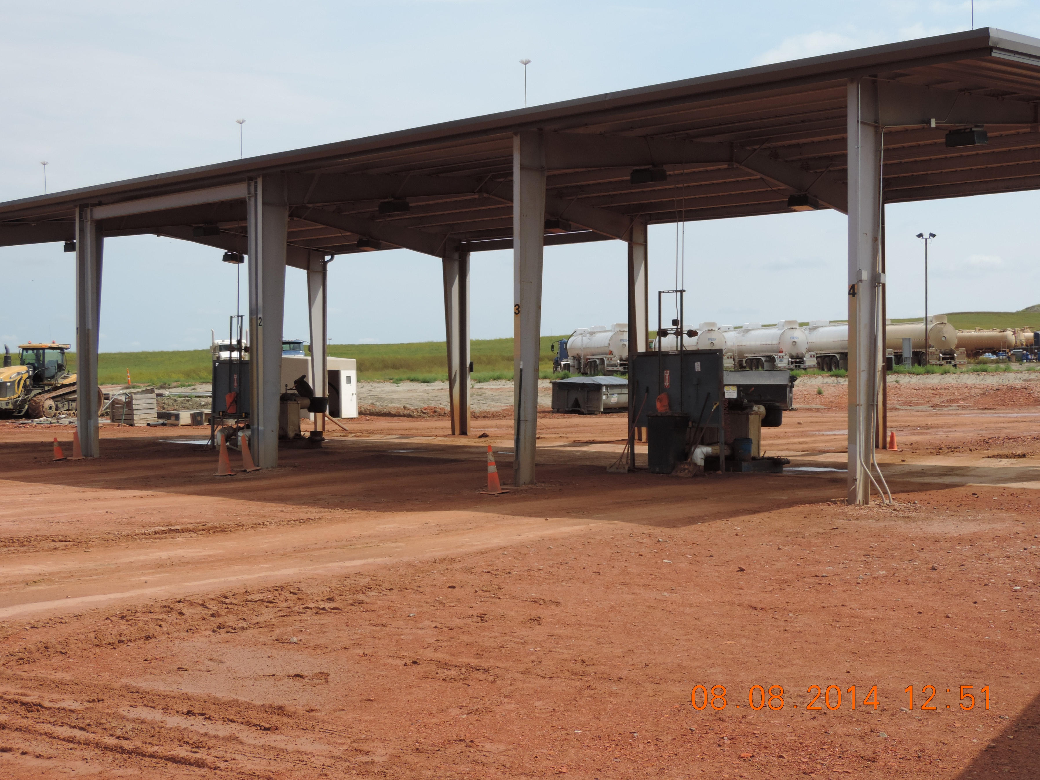

Slide 16
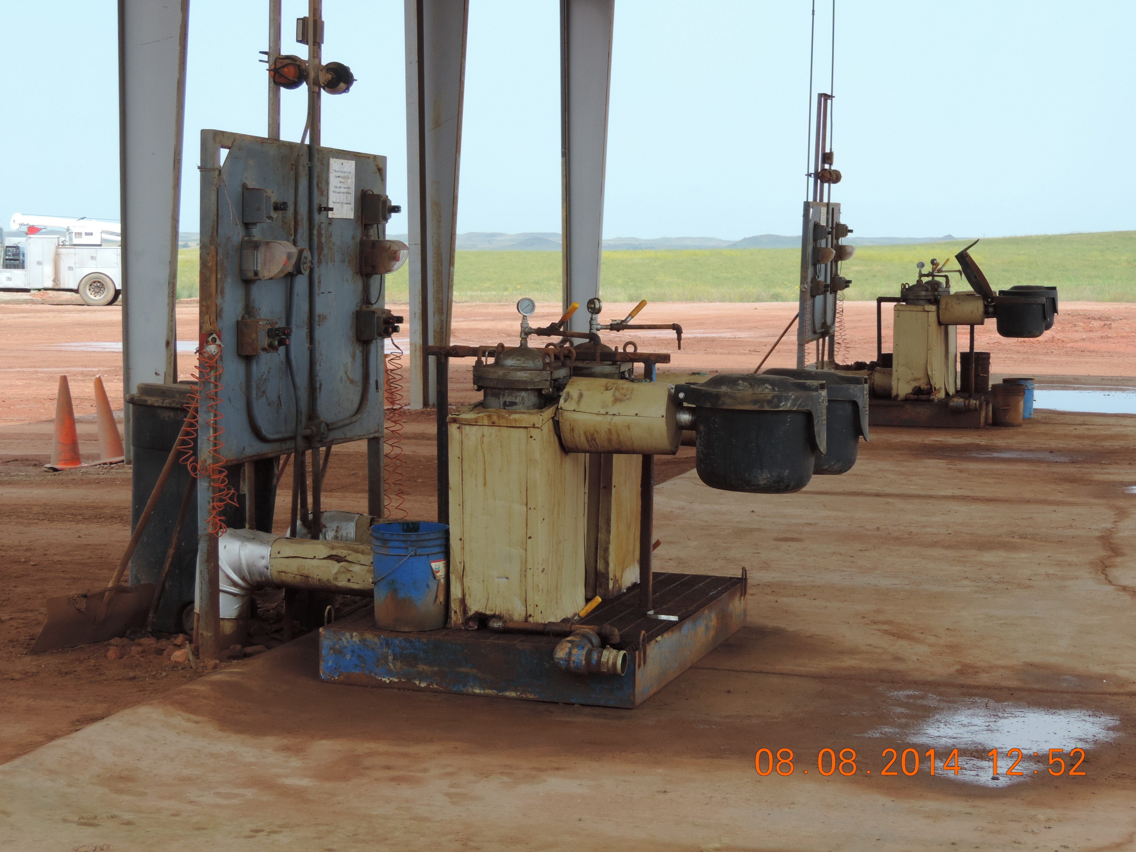

Slide 17
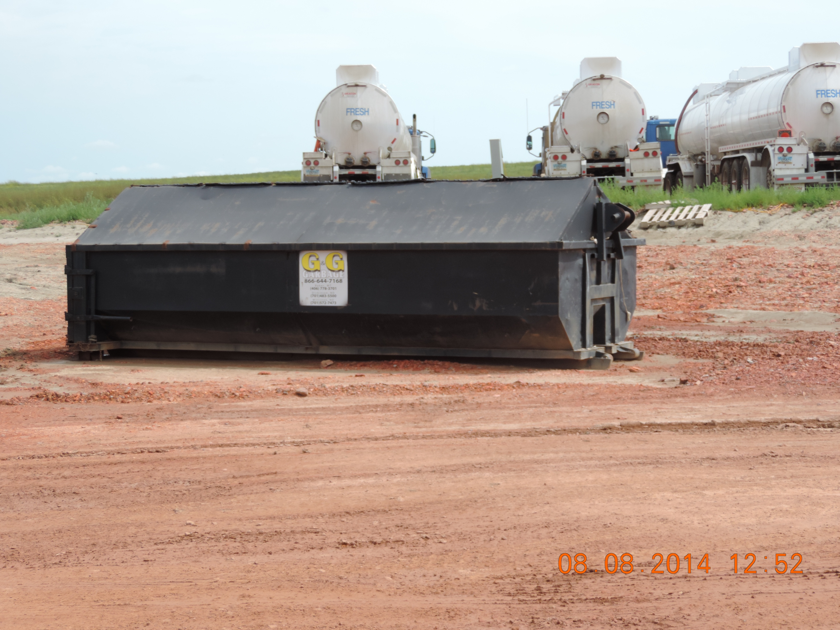

Slide 18
July 1, 2014
Leak Tight containers required
Must have a Solid Waste Haulers Permit
Drivers must have HAZMAT endorsement
Each Company must supply letter to Department stating the name of the individual responsible for the program
Must submit quarterly load reports
Must be registered with the Secretary of State
Must have a Radioactive Materials Haulers license

Slide 19
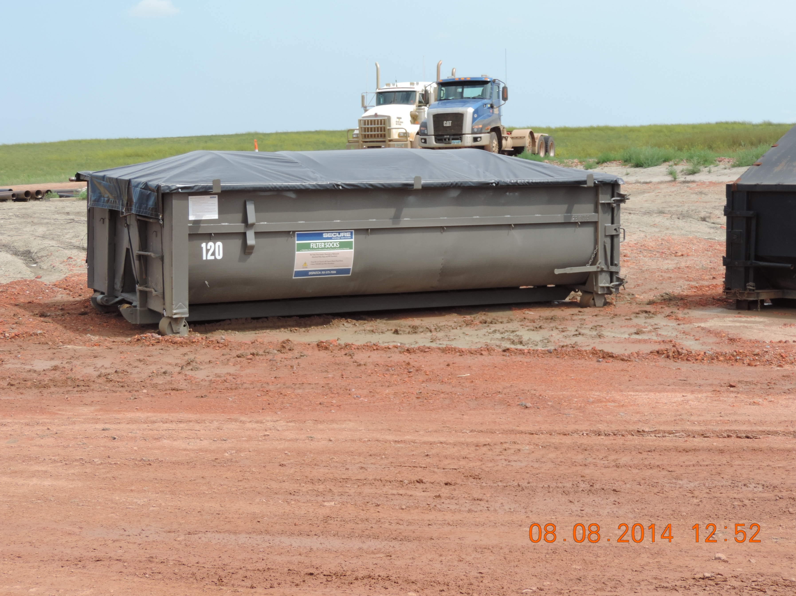

Slide 21
Fracturing process cont.
Purposes of fracture fluid
• crack the reservoir
• to carry Propants to hold the shale fractures open so oil can flow
Interesting enough is that much of the Propant used has some radioactivity associated with it.
Some propants come from China and seem to be more radioactive that materials that originate in the US

Slide 22
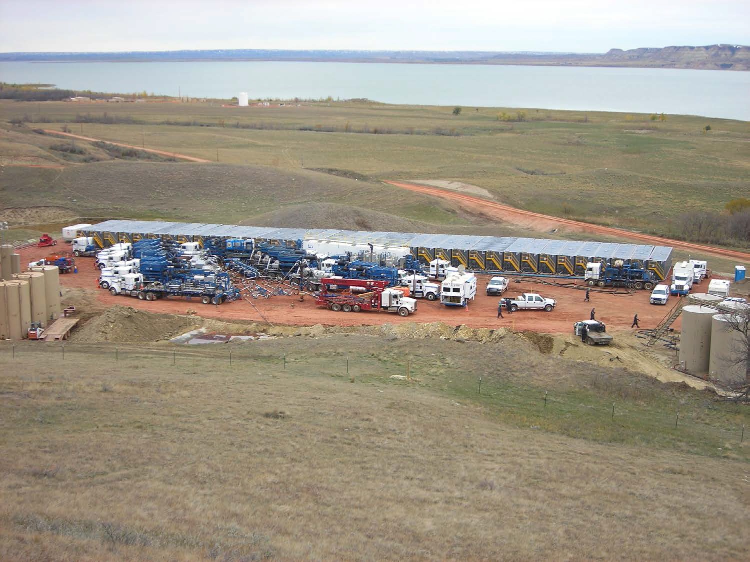

Slide 23
NORM
Some of the radioisotopes found in the soils of North Dakota are:
Radium 226
Radium 228
Lead 210
Potassium 40

Slide 24
Here Come the Filter Socks!

Slide 25
A Small Sample from North Dakota
Nearly 150 Illegal Oil Waste Dumps” – AP
“Filter Sock Mess Could Lead to Enforcement Action” – Bismarck Tribune
“Watford City Struggles with Radioactive Oil Waste” – Billings Gazette
“Strange Byproduct of Fracking Boom: Radioactive Socks” – Forbes
“Officials, Operator to Meet in Filter Socks Probe” – KX News

Slide 26
Trailers with stored socks

Slide 27
Oil Contamination

Slide 28
Bags contain Filter Socks

Slide 29
Unused Filter Sock

Slide 30
Abandoned Gas Station

Slide 31
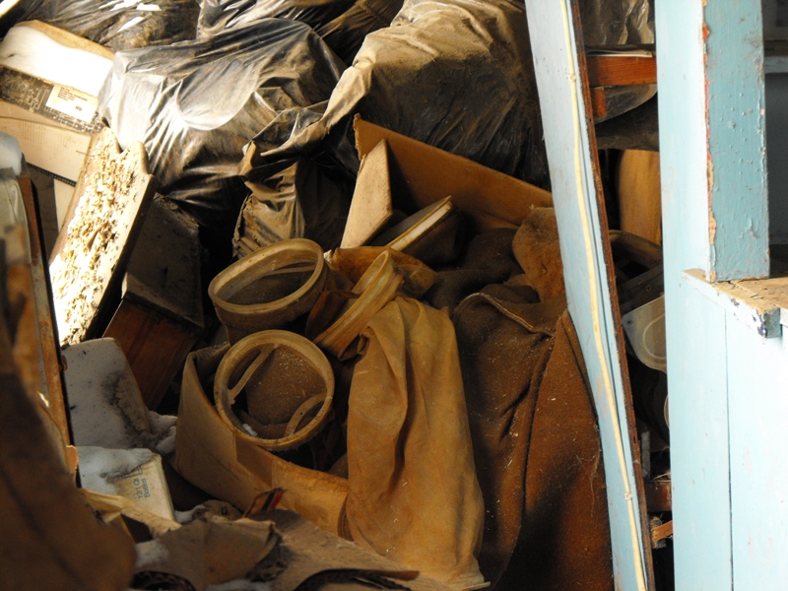
This is what we found.

Slide 32
2-20 yard Rolloff containers

Slide 33
Crosby Location

Slide 34
Background Measurements
Early work done in 1984-1986 by USEPA-ORP out of Las Vegas regarding background radiation levels
Work was done in western North Dakota as part of the UMTRA program
Background levels for Ra-226 found to be 4.2 pCi/gm during this work
Origination of 5 pCi limit for disposal in North Dakota

Slide 35
Rules?
That which is not reserved to the feds stays with the states or the people
States therefore have the responsibility for those things not reserved to the feds:
Machine generated materials
NORM/TENORM
1978 amendments to the AEA – UMTRCA expanded federal authority to cover uranium mill tailings
Vanadium tailings or radium tailings from the same type of ore not captured by AEA
However, radionuclides are considered hazardous air pollutants under the Clean Air Act, which opened the door for additional federal regulation.

Slide 36
States regulatory structure
About a dozen states have some specific regs for TENORM
Patterned after early drafts of CRCPD Part N
Mostly addresses solids and licensing
Weak on liquids
Most were adopted by oil and gas producing states
Pipe scale
Land contamination

Slide 37
Currently in North Dakota
Currently the solid waste disposal limit for TENORM in North Dakota is 5 pCi
Landfills levy fines of $1,000.00 per filter sock if found in the load presented for disposal
TENORM waste (filter socks, sludge, pipe scale, etc) is transported out of state
Risk Assessment study currently underway with Argonne National Labs to possibly increase the disposal limits

Slide 38
Argonne National Laboratory
Radiological Dose and Risk Assessment of Landfill Disposal of Technologically Enhanced Naturally Occurring Radioactive Materials (TENORM) in North Dakota
Draft Report

Slide 39
TENORM WASTE STREAMS
Produced Water
Scale
Sludge and Filter Cake
Filter Socks
Lead-210 Deposits in Gas Equipment
TENORM-Contaminated Equipment
TENORM-Contaminated Soils
Synthetic Fracturing Proppant

Slide 40
North Dakota TENORM Waste Characterization Data
Type of Waste Scale Sludge Filter Sock Proppant
Average Ra-226 (pCi/g) 548 58.3 32.8 8.2
Maximum Ra-226 (pCi/g) 4,710 1,230 374 9.1
Average Ra-228 (pCi/g) 332 15.4 13.8 9.9
Maximum Ra-228 (pCi/g) 3,590 66.3 130 11.2
Number of Samples 38 57 18 6
Average Pb-210 (pCi/g) 5,270 67.2 36.9 8.5
Maximum Pb-210 (pCi/g) 5,270 318 70 9.74
Number of Samples 1 7 17 6
Average Th-232 (pCi/g) 71.7 17.2 12.7 9.1
Maximum Th-232 (pCi/g) 460 97.5 18.9 10.2
Number of Samples 27 50 2 6

Slide 41
DOSE AND RISK ASSESSMENT RESULTS
Well Site Workers
Public Exposure Scenarios
Future-Use Scenarios
Risk from Landfill Operations
Transportation Scenarios

Slide 42
Waste Streams Used in Evaluating Radiation Dose in Different Worker and Public Scenarios from Well Site Operations
Mixing hydraulic fracturing fluid Proppant
Produced water filtration Filter cake and filter socks
Pipe cleaning Scale
Storage tank cleaning Sludge
Gas processing Pb-210 film
Sludge treatment Sludge
Filter socks used a toy Filter socks
Filter socks dumped in a dumpster Filter socks
Illegal dumping of proppant on a field Proppant

Slide 43
Estimated Maximum Dose Rate (mrem/yr) Using Max Radionuclide Concentration
Operations Exposure Direct External Ingestion Total Dose Rate
Source Exposure (mrem/yr)
Mixing hydraulic fracturing fluid Proppant 23 NA 23
Produced water filtration Filter socks 0.36 1.8 2.2
Pipe cleaning Scale 130 NA 130
Storage tank cleaning Sludge 70 NA 70
Equipment cleaning at gas processing Pb-210 film 0.012 NA 0.012
Sludge treatment workers Sludge 30 NA 30
main contributor to dose for the well site worker scenarios is Ra-226 and Ra-228; the exception is for the worker cleaning equipment at a gas processing facility for whom only Pb-210 is a radionuclide of concern.

Slide 44
Well Site Operation Worker Scenario Sensitivity for PPE

Slide 45
North Dakota is Developing Rules
CRCPD Part N – modified to include Solid Waste Program
North Dakota is licensing those companies that treat TENORM (must have trained RSO)
Transfer stations require licensure
TENORM transporters are required to be Licensed
Solid waste permit required
Registration with the Secretary of State is required
Drivers must have HAZMAT endorsement
Quarterly load reports are required
Must have a qualified person responsible for their program

