Slide 1
Leading the Radioactive Waste Disposal Market

Slide 2
Summary
EnergySolutions organization
Meeting the challenges of the changing market environment
Updates
  Transportation
  Disposal
  Processing
  Decommissioning
Meeting customer needs

Slide 3
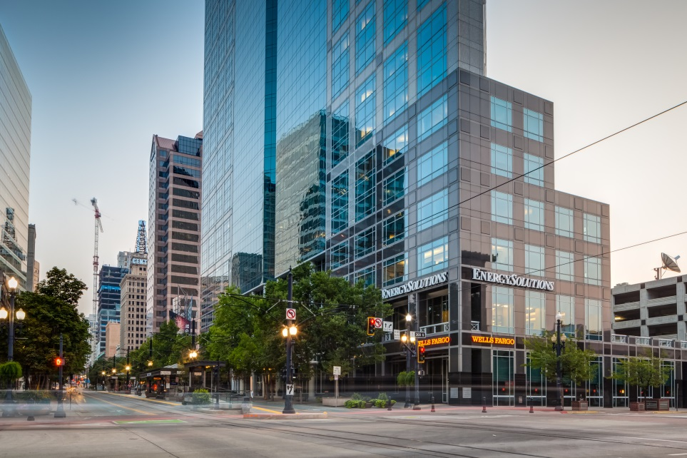
Company Focus in 2015
Focus on Safety
Meeting the customer’s changing needs
Market demands mean greater efficiency
Growing the business
Moved to new headquarters in May
EnergySolutions’ new headquarters in Salt Lake City

Slide 4










Who is EnergySolutions?
    Acquired June 2006 (US)
    Vertically integrated nuclear material processing and disposition
    Transportation assets, engineering and O&M
    Long-standing relationship with DOE, DOD & commercial customers
    Center for metal recycling operations
    Acquired June 2007 (UK)
    Reactor Sites Management Company owners of Magnox Electric Limited – Magnox South and Magnox North
    10 reactor sites, two of which generate nuclear power
    Acquired February 2005 (US)
    Leading LLRW disposal site in the U.S.
    Manages over 90% of off-site LLRW disposal capacity
    Acquired September 2005 (US)
    D&D services
    Characterization and packaging
    Acquired June 2007(US Assets)
    Full service waste management
    Engineering and consulting, fuel cycle
    services, decommissioning, waste treatment
    Acquired February 2006 (US Assets)
    Nuclear D&D, design and engineering
    Long-term relationship with U.S. DOE
    Rights to BNFL reprocessing and waste management technology
    Acquired July 2007 (Canada)
    Nuclear waste management
    Laboratory & analytical
    Consulting
    Acquired March 2015 (US)
    Multimodal ​transportation​, specialized packaging and high-capacity rail equipment
    ​National network of transload facilities
    Logistics services for environmentally sensitive materials
    Acquired December 2006 (US)
    Engineering, project licensing & auditing
    Deepens significant nuclear services
    expertise and management talent
    Acquired March 2014 (US Assets)
    Nuclear waste management
    Niche thermal treatment of resins
    Additional transportation casks
Notes:
Studsvik Acquisition – Brought us the ability to process high activity waste business, a challenge that faced the industry since Barnwell closed in 2008.

Slide 5
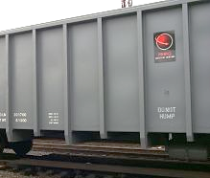
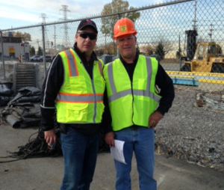
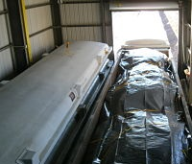
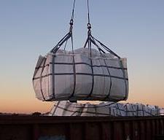
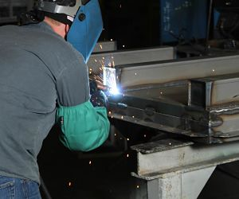
MHF Services Acquisition: March 2015
Integrated packaging, transportation and logistics provider for radioactive, hazardous, and non-hazardous waste and materials
Multimodal ​transportation​, specialized packaging and high-capacity rail equipment with a special emphasis on radioactive waste management
​National network of transload facilities for bulk and packaged materials
Logistics and technical services by highly experienced hazardous materials & logistics professionals
​20-year history of asset-based, rail-centric logistics with an impeccable safety and regulatory compliance record​
MHF Provides Integrated Technical, Packaging and Transportation Logistics Services

Slide 6
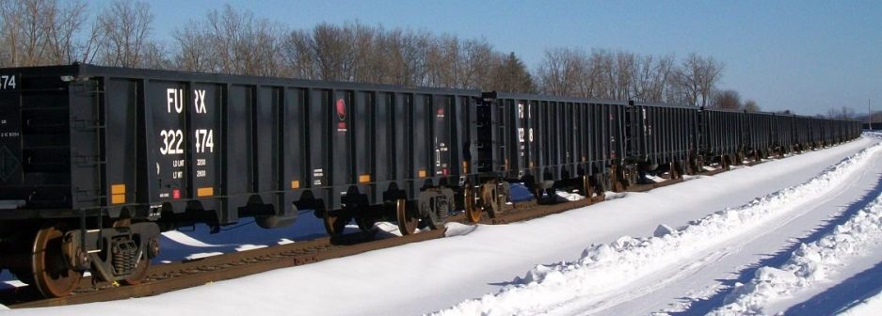
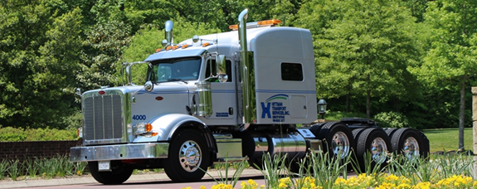
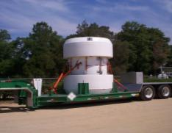
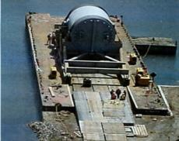
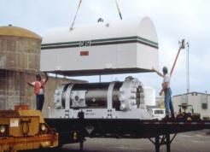
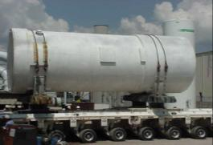
Logistics
Includes Hittman, MHF Services, Rail Transportation
Dedicated fleet of tractors, trailers, railcars, and containers
Over 9 miles of onsite rail for efficient and cost-effective waste handling at Clive
92 DOT/NRC Licensed Casks
EnergySolutions Operates the Largest Cask Fleet in North America
Notes:
Energy Solutions transportation arm is Hittman Transportation
Over 35 years of safe nuclear transportation
Annual average of 14,000 shipments
Annual average of 8M miles (12.9M kilometers) logged
Excellent safety record - maintains satisfactory highway
safety rating (highest rating issued by the DOT)
Largest dedicated fleet of tractors & trailers
Transportation logistics via road, rail, & water
Comprehensive fleet of IP1 and IP2 ISO containers and tankers
Proprietary cask fleet (Type A & B)

Slide 7
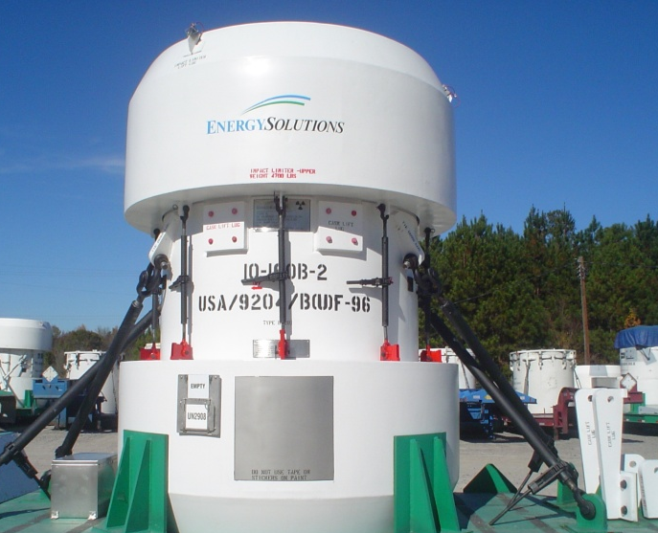
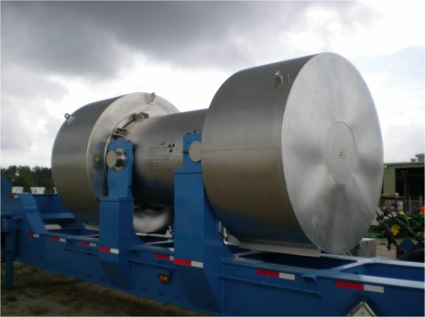
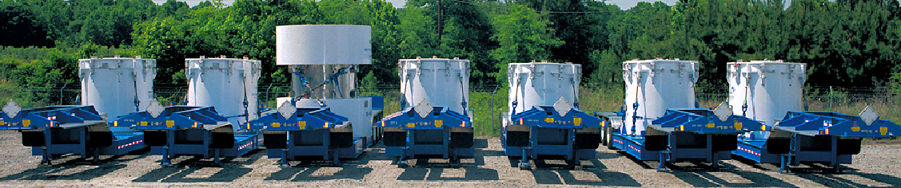
Update on Casks
92 Casks in fleet
Easy to use/proven experience
EnergySolutions owns 90% of casks currently in use
Logged more than 70 million safe driving miles without a loss or spill of radioactive materials
EnergySolutions Added 1 New Cask in 2015 3-60B
Notes:
Have a canned answer on casks

Slide 8
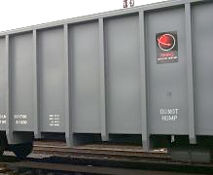
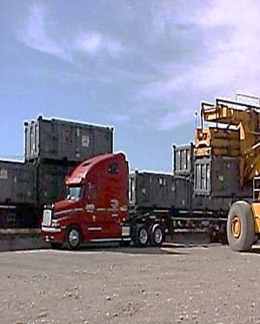
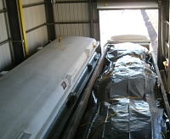
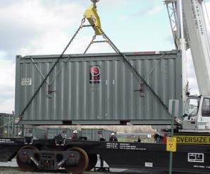
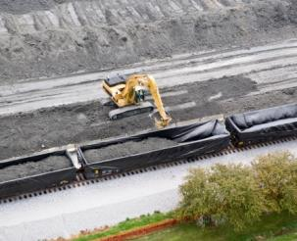
MHF Acquisition
1,000+ Railcars
600+ Railcar Lids
2,000+ Containers
Flexible Packaging
Metal Packaging
LLRW and Haz/Non-Haz Markets
MHF has the largest privately held equipment fleet in the industry.
8

Slide 9
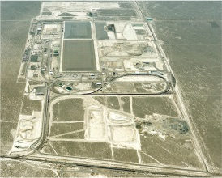
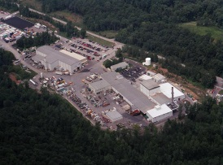
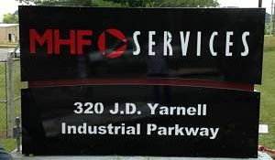
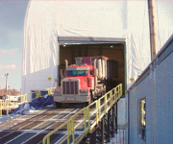
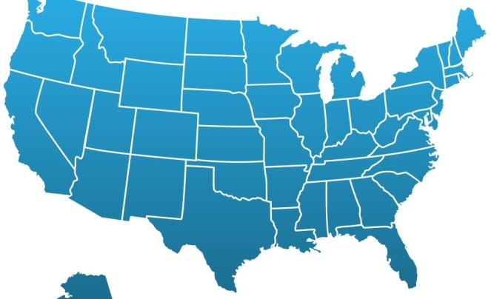
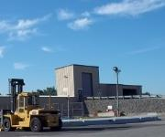
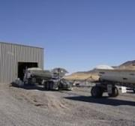
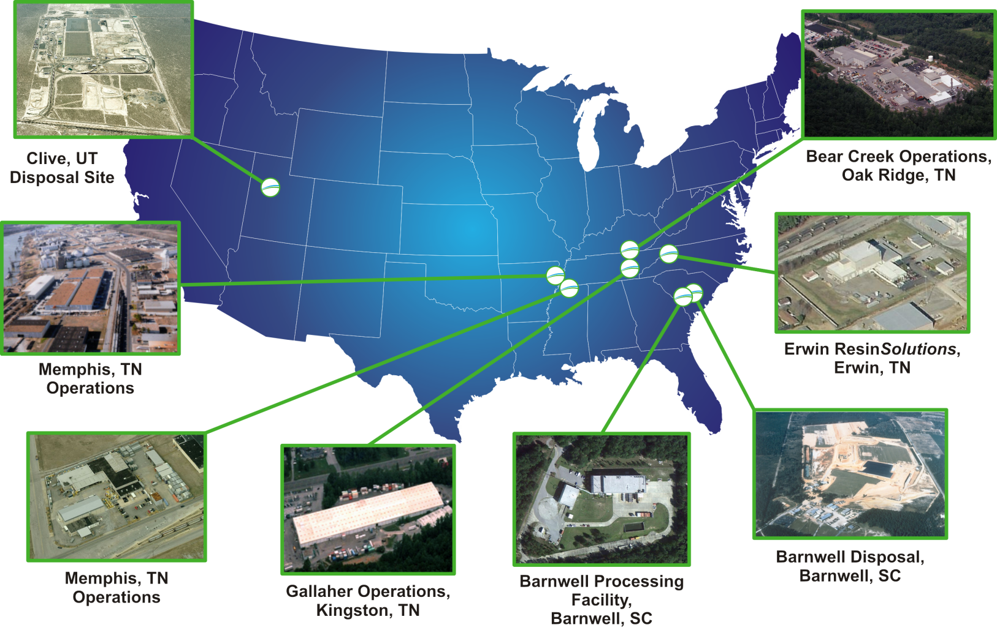
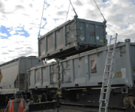
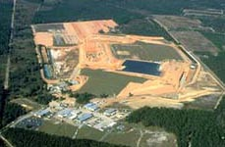
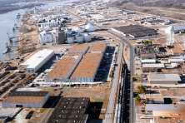

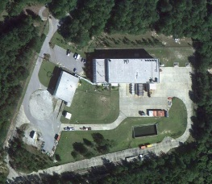
Facilities
Bear Creek
Operations,
Oak Ridge, TN
MHF
Operations,
Clinton, TN
Worcester, MA Transload
Clive, UT
Disposal Site
North Bergen, NJ Transload
Dunphy, NV Transload
Erwin ResinSolutions
Erwin, TN
Parker, AZ Transload
Barnwell Disposal Barnwell, SC
Memphis, TN
Operations
Heritage Center Industrial Park
Oak Ridge, TN
Transload
Gallaher Operations
Kingston, TN
Barnwell
Processing Facility
Barnwell, SC
Notes:
Worcester: Located in Worcester Mass and is primarily used for open air haz and non haz transfer from truck to rail. Located on the Providence and Worcester Rail Road. Can and have transferred packaged radioactive wastes.
Bergen: Located in North Bergen, NJ and is primarily used for open air haz transfer from truck to rail. Located on the New York, Sequehanna & Western Rail Road. Can and have transferred packaged radioactive and non haz wastes.
Clinton: Fabricate metal and flexible packages for radioactive and hazardous wastes. 200K square foot with rail and barge access.
Parker AZ: Primarily used for transferring materials from rail to Truck for access to the NNSS. Operated on an as needed basis.
Dunphy, NV: On Newmont property and used to transfer their copper concentrates from truck to rail for shipments to Canada and Ports for oversees export.

Slide 10
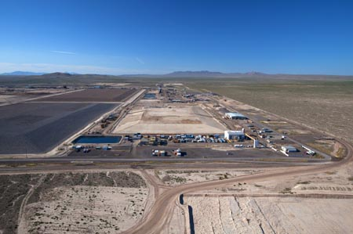
Clive Disposal Facility
Over 27 years experience treating and disposing of radioactive waste
One-of-a-kind bulk waste and containerized waste facilities with unique licenses and permits
  Radioactive Material Licenses (LLRW & 11e(2))
  RCRA Permit (Treatment & disposal of MW)
  TSCA Permit (PCB waste streams)
  SNM Exemption (Concentration based limits)
Long-term federal and commercial contracts
Notes:
Still the only licensed commercial Class A Facility.
Managed by Dave Squires

Slide 11
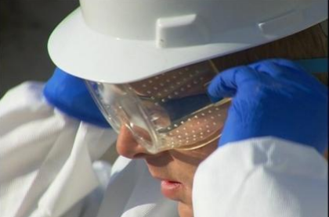
Clive Safety Update
Last lost time injury was November 2010
Hours without lost time injury: 1,437,517
Last recordable was 10/15/2013
Hours since last recordable: 392,756
Clive average dose:
2014 = 0.028 rem
2015 (July) = 0.026 rem
Clive facility was awarded NSC
Award for Safety in 2012, 2011 and 2010

Slide 12
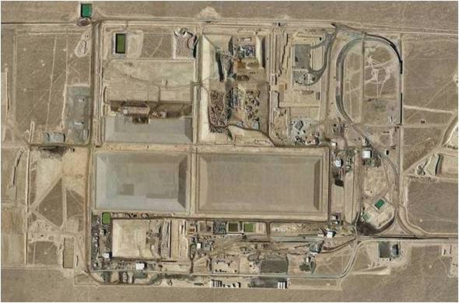
Clive Disposal Capabilities
Bulk Waste Disposal
Containerized Waste Facility
Large Components
Mixed Waste Treatment
  Macro
  Stabilization
  Liquid Solidification (LLRW and MW)
  Thermal Desorption
PCBs

Slide 13
Clive – Depleted Uranium
JUN
2014
SEP
2014
OCT
2015
MAY
2016
OCT
2016
Performance Assessment Submitted
Review Begins
Revised
DU PA Application Filed with DWMRC
Public Comment Restarted
Public Meetings
DRC Director’s Decision
Notes:
The department of environmental quality (DEQ) ask EnergySolutions to complete a performance assessment (PA) on Clive to see if the facility was suitable for the disposal of DU. Once the PA was complete a third party was hired by the division of radiation control (DRC) to evaluate the PA.
Earlier this year the evaluation was completed and it was determined there are 8 "concerns" that needed to be addressed. We are in the process of addressing those concerns and are confident we will be able to satisfy the concerns raised.
Once we are able to adequately address those issues we are confident the result will be that Clive is suitable for the long term disposal of DU.
Two of the concerns we are currently focused on and addressing include satisfying the question of deep time analysis and the question of weather or not DU will be reclassified by the NRC as greater than Class A waste.

Slide 14
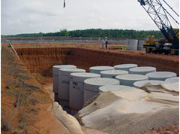
Barnwell Update
August 2015 Court of Appeals Decision; Determining path forward
Received 10,647 cubic feet of A, B, and C waste in 2014 and expect 11,790 cubic feet in 2015
Cover construction complete on 99% of the completed portions of the site
The Barnwell Disposal facility accepts Class A, B & C waste from Generators in the Atlantic Compact
Notes:
Get a narrative from Potter on Barnwell.

Slide 15

Barnwell Safety
Last lost time injury was 6/6/2013
Hours without lost time injury: 294,908
Last recordable was 6/11/2013
Barnwell average dose: 2014 = 0.080 rem
2015 (July) = 0.208 rem
The EnergySolutions Barnwell facility received the 2013 SC Chamber of Commerce Safety Award

Slide 16
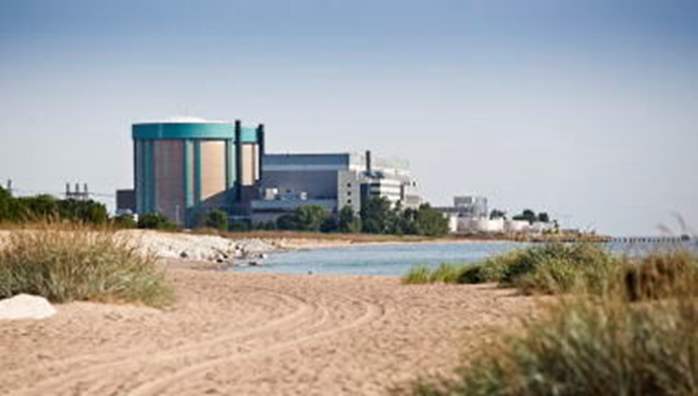
Zion D & D Update
Ahead of Schedule
On Budget
2015 Major Accomplishments
  Successful Fuel Transfer
  B & C Waste Packaged and Transported
  Reactor Segmentation
    Oxy Propane cutting torch
    Shipped to Clive via rail
Notes:
2015 accomplishments should include: Completion of ISFSI project & reduction of site protected area to only the ISFSI perimeter; demolition of Turbine Building initiated, both Rx Vessels dissected and disposed; Containment Building Tendons removed; major component disposition underway; xxxx lbs of rad material safely transported and disposed at Clive....

Slide 17
Video of Zion project
Roll video

Slide 18




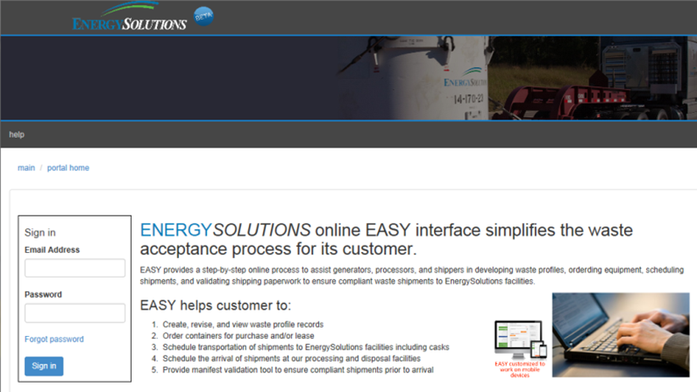

Customer Portal
Electronic Access SYstem (EASY)
Step-by step online guide for generators, processors and shippers
Accessible via www.energysolutions.com
Recently updated with cask information and licenses/WACs
Coming soon: Ability to track EnergySolutions equipment (trucks, trailiers, casks, etc.)
Create, revise, and view waste profile records online
Order containers for delivery
Schedule shipments to EnergySolutions facilities
Schedule arrival of shipments at our processing and disposal facilities
Validate Uniform LLRW manifest to ensure compliant shipments prior to arrival

Slide 19

2016 Customer Conference
January 13-15, 2016
Industry leaders providing perspective and updates to major initiatives
Great venue to interact with experts in radioactive waste management across the industry
Two-day DOT training refresher, WAC update, and Customer Portal training provided in advance of the conference (accredited training)

Slide 20
Summary
A Global Nuclear Solutions Company
Strong in Both Commercial, Government & International Markets
Fully Integrated Across the Nuclear Fuel Cycle
Reputation for Innovation, Quality, Safety & Performance
A Trusted Strategic Alliance Partner

