Slide 1
NRC’s LLW Regulatory Program: Update of Emerging Issues
April 24, 2017
LLW Forum Meeting
Denver, Colorado
Andrea Kock, Deputy Director
Division of Decommissioning, Uranium Recovery,
and Waste Programs (DUWP)
Office of Nuclear Material Safety and Safeguards (NMSS)

Slide 2
Objective
To discuss the progress and next steps on several items related to the NRC’s Low-Level Radioactive Waste (LLW) Program and 2016 LLW Programmatic Assessment including:
Proposed Final Part 61 Rulemaking
Low Activity Waste
Byproduct Material Financial Assurance

Slide 3
Key Messages
The NRC staff is making progress on several significant aspects of the 2016 Programmatic Assessment
Stakeholder input will be necessary to inform the NRC’s approach on several issues
The NRC is open to additional discussion on implementation of new regulatory initiatives

Slide 4
10 CFR Part 61 Rulemaking
4

Slide 5
Status
2/12/14
3/26/15
9/16/16
Proposed Rule and Associated Draft Guidance Issued
Final Rule to Commission
Commission Approved Proposed Rule
SECY-16-0106: ML16188A290
5

Slide 6
NRC Byproduct Material Financial Assurance Update
6

Slide 7
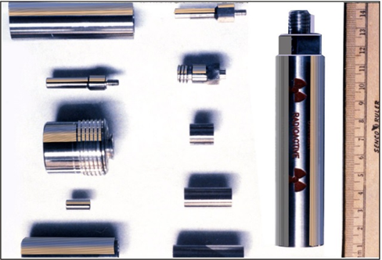
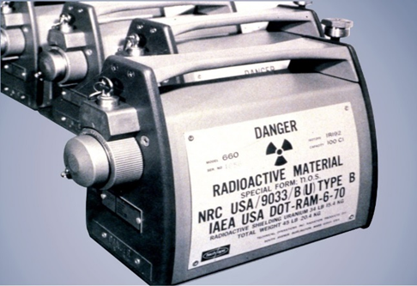
Background
NRC’s regulatory threshold in 10 CFR 30.35 for providing decommissioning financial assurance is higher than most Category 1 and 2 radioactive sealed sources (RSSs)
For sources below the threshold, there is no requirement for financial assurance for decommissioning or end-of-life financial planning
This does not relieve the licensee from the responsibility of proper end-of-life management
Financial burden may be significant
7

Slide 8
Recent History
Tasking to complete scoping effort arose from a September 2014 Commission briefing on radioactive waste issues
Staff stressed the timeliness of completing the byproduct material scoping study citing:
March 2014 Report by the LLW Forum Disused Sources Working Group
August 2014 Radiation Source Protection and Security Task Force Report
Resulting Staff Requirements Memorandum (SRM-M140918) directed staff to provide “…results of the byproduct financial scoping study and recommendations on next steps”
8

Slide 9
Scoping Study Results
The NRC staff recommended rulemaking to expand the financial assurance requirements in 10 CFR 30.35 to include all byproduct material Category 1 and 2 RSSs tracked in the National Source Tracking System
This recommendation focuses on RSSs with the highest risk significance. Staff believes these additional requirements:
Should reduce the likelihood that some licensees will be unprepared for disposition costs
May help reduce the use of long-term storage as a management option consistent with Commission policy favoring disposal over storage
Would ensure that the disposal cost of using these RSSs is appropriately borne by those who receive economic benefits from their use
9

Slide 10
Rulemaking Plan
The NRC staff prepared a rulemaking plan SECY paper to further evaluate potential changes to 10 CFR 30.35, as required by SRM-SECY-15-0129, “Commission Involvement in Early Stages of Rulemaking”
This plan is documented in SECY-16-0115 (ADAMS Accession No. ML16200A223) dated October 7, 2016.
10

Slide 11
Rulemaking Plan Recommendations
The NRC staff concluded that the proposed rulemaking:
is the most effective way to ensure that adequate financial resources are available to disposition Category 1 and 2 byproduct material RSSs
would be a high priority based on its contribution to NRC Safety and Security Goals
would improve the effectiveness of the regulatory framework
would address issues identified by several internal and external groups
The NRC staff recommended that the Commission approve the initiation of rulemaking to expand the financial assurance requirements in 10 CFR 30.35
Alternatives to rulemaking and the specifics of the rule would be explored as part of the rulemaking process
11

Slide 12
Low Activity Waste
Purpose of the study
Divergent stakeholder comments
Options offer a range of costs and benefits
Path forward

Slide 13
Questions?
13

