Slide 1
Low-Level Radioactive Waste Forum
Spring 2017 Meeting – Denver, CO
April 24, 2017
Utah Activities Update
Rusty Lundberg
Deputy Director

Slide 2
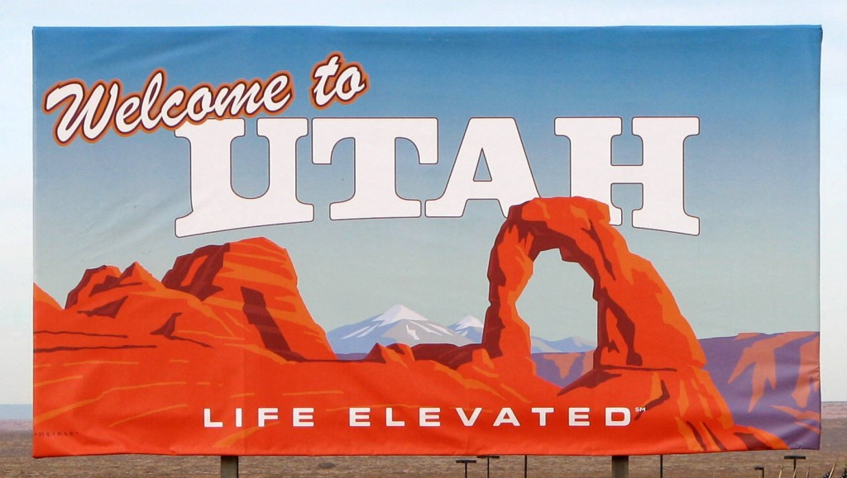

Slide 3
Utah Activities Update
NRC – IMPEP Follow Up
November 3, 2016
November – December 2017
Legislation
Senate Bill – Financial Assurance
House Bill – Perpetual Care Funding
Clive Facility
Low-Level Radioactive Waste
11e.(2) Byproduct
Mixed Waste
Public Outreach

Slide 4
IMPEP Review – Follow-up Evaluation
IMPEP – July 2015
November 3, 2016 – Follow up to the July 2015 full IMPEP review conducted by the NRC
Status of addressing the incompatibility finding associated with statutory requirements for financial assurance for LLRW management facilities
2015 Findings:
Limited financial assurance coverage for commercial radioactive waste treatment and disposal facility to the landfill embankments where waste was disposed
Allowed licensee to update financial assurance annually without a detailed review by the Division to assure sufficient funds are available for site closure

Slide 5
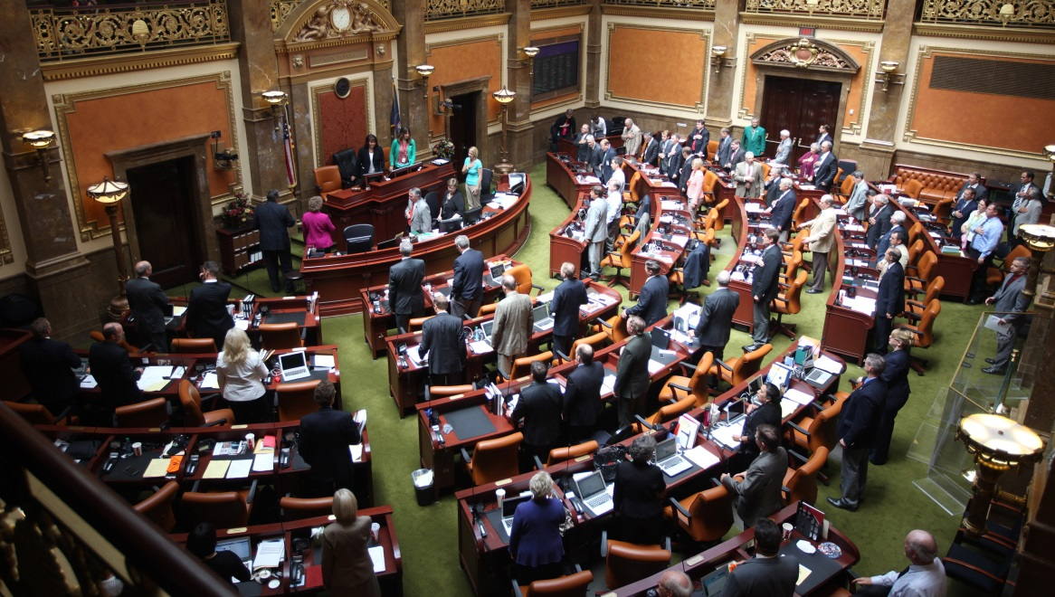
2016 Follow-up Evaluation
“At the time of the periodic meeting, the Division planned to incorporate NRC comments and develop revised legislation for the 2017 legislative session. The recommendation is still open pending the outcome of the legislative changes.” (ML16354A220)

Slide 7
Utah Legislation – 2017 General Session
NRC review of 2017 legislation to address incompatibility items
“… Utah’s legislation states, ‘the licensee or permittee shall annually propose closure and postclosure costs upon which financial assurance amounts are based, including costs of potential remediation at the licensed or permitted facility and, notwithstanding the obligation limitations described in Subsection (12)(b), any unlicensed facility.’
“The phrase, ‘notwithstanding the obligation limitations described in Subsection (12)(b)’
should … be … changed to read, ‘notwithstanding the obligations described in Subsection (12)(b)’. This is to ensure that (12)(e) is consistent with (12)(b), because the limiting language in (12)(b), ‘shall be limited to,’ was replaced with ‘shall include.’”

Slide 9
2017 Utah Legislation – Financial Assurance
Senate Bill 79 – Waste Management Amendments
Resolves incompatibility issues
Defines “unlicensed facility”
Modifies financial assurance requirements for licensed and unlicensed areas of a LLRW disposal facility
Clarifies the definition of a Radioactive Waste Facility

Slide 10
EnergySolutions – Clive

Slide 11
2017 Utah Legislation – Perpetual Care Funding
House Bill 296 – Radioactive and Hazardous Waste Account Amendments
Modifies the perpetual care requirements:
Eliminates requirement for a LLRW disposal facility to pay $400,000 annually
Eliminates requirement to evaluate and report every 5 years on the adequacy of funds for closure, post-closure, and perpetual care and maintenance of commercial HW and LLRW treatment and disposal facilities unless a 25% increase in size occurs

Slide 12
2017 Utah Legislation – Perpetual Care Funding (cont.)
House Bill 296 – Radioactive and Hazardous Waste Account Amendments
Modifies the perpetual care requirements:
Allows State Treasurer to invest the current perpetual care balance in a more robust investment option
Requires State Treasurer to report to the Legislature every 5 years on the account status – can request more funds if the investment is not meeting targeted growth

Slide 13
EnergySolutions – Clive
Photo - EnergySolutions

Slide 14
EnergySolutions – Clive – LLRW
Evaluation of Performance Assessments
Erwin ResinSolutions (SempraSafe) evaluation
EnergySolutions recently withdrew its request for approval of large scale disposal
Division evaluating response
Depleted Uranium
Schedule
Web site
LLRW DISPOSAL

Slide 15
EnergySolutions – DU Performance Assessment
http://www.deq.utah.gov/businesses/E/EnSolutions/depleteduranium/performassess/index.htm

Slide 16
EnergySolutions – Clive – LLRW
License renewal – License out for public comment before the end of this year
Oversight
Incoming shipments
Containerized waste – waste classification verifications
Waste management operations & site monitoring program
Groundwater Permit Amendments
LLRW DISPOSAL

Slide 17
EnergySolutions – Clive
11e.(2) Byproduct Material
License renewal – Division is hoping to have this license out for public comment by the end of this year.
Implementation of additional public participation procedures required by § 274 (o)(3) AEA
Written comments & public hearing, with a transcript
Cross Examination
Written determination based on findings
DOE long-term stewardship
11e.(2) Byproduct Disposal

Slide 18
EnergySolutions – Clive
Mixed Waste
Permit is ready for renewal
EPA evaluating allowing macro encapsulation in the landfill cell
DWMRC pursuing an approach to resolve before the permit is renewed – awaiting a response from EPA
Mixed Waste Disposal

Slide 19
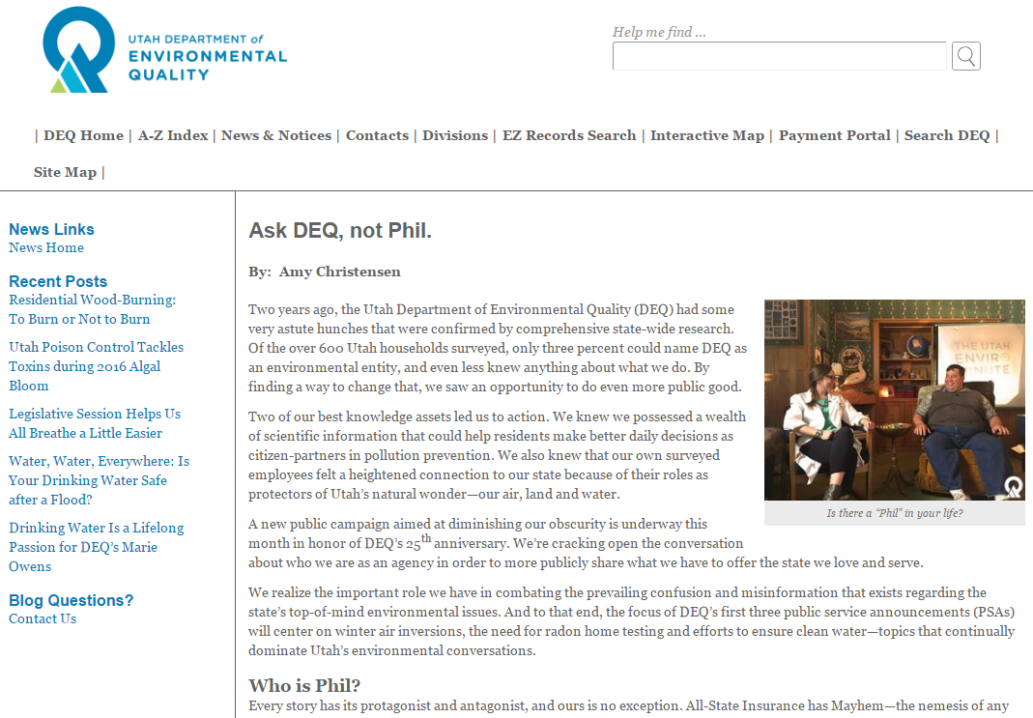
Utah DEQ – Public Outreach – Ask DEQ, Not Phil
https://deq.utah.gov/news/ask-deq-not-phil

Slide 20
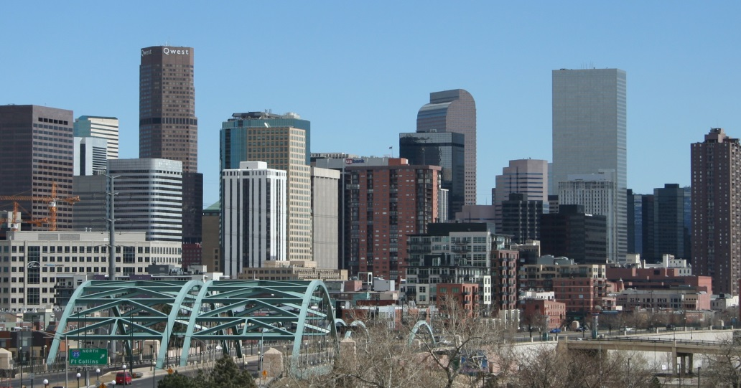
Thank You
Rusty Lundberg
Deputy Director
Division of Waste Management and Radiation Control
Utah Department of Environmental Quality
(801) 536-4257
rlundberg@utah.gov

