Slide 1
Overview of Waste Disposition Activities Spring 2017 LLW Forum Meeting
Doug Tonkay
Director of Waste Disposal
Office of Environmental Management
April 25, 2017

Slide 2
Overview
The Current EM Organization Structure
Low-Level Radioactive Waste (LLW) Policy & Goals
Status on Greater-Than-Class C (GTCC) LLW and GTCC-like Waste Disposal
Update for Waste Isolation Pilot Plant (WIPP) and Transuranic (TRU) Waste Across the DOE Complex

Slide 3
The EM Organization
EM-1 Assistant Secretary
Sue Cange, Acting
EM-2 Acting Principal Deputy Assistant Secretary
Sue Cange
Savannah River
National Laboratory
Policy Office
EM-2.1
Chief of Staff
Betsy Connell
- International Program
- Correspondence Center
EM-4
Regulatory and Policy Affairs
Frank Marcinowski, APDAS
Vacant, Deputy Chief
EM-3 Field Operations
Stacy Charboneau, APDAS
Kirk Lachman, Deputy Chief
EM-5
Corporate Services
Candice Trummell, APDAS
Jason Donaldson, Deputy Chief
EM-4.1 Infrastructure Management and
Disposition Policy
Barton Barnhart, Director
4.11 Infrastructure and D&D (Andy Szilagyi)
4.12 Subsurface Closure (Kurt Gerdes)
EM-3.1 Safety, Security, and Quality Assurance
Jim Hutton, DAS Greg Sosson, ADAS
3.11 Field Operations Oversight/CNS Greg Sosson, ADAS
3.111 Safety Management (Jomaries Rivera, Acting)
3.112 Operational Safety (Terrance Tracey)
3.113 Standards and Quality Assurance (Robert Murray)
3.114 Safeguards, Security, and Emergency Preparedness (Jimmy McMillian)
Field Operations
Carlsbad
Richland
Idaho
Savannah River Site
Oak Ridge
Office of River Protection
Portsmouth & Paducah
EM CBC Field Support
Los Alamos
Moab
SPRU
ETEC
WVDP
NNSA EM Projects (NNSS, LLNL, SNL)
HQ Field Liaisons
EM-5.1 Resource Management
Jason Donaldson, Acting DAS
Melanie Bell, ADAS
5.11 Budget and Planning (Steve Trischman)
5.111 Budget (Michele Torrusio)
5.112 Program Planning (Lois Jessup)
5.12 Information Systems (Jeanne Beard)
5.13 Workforce Management (Mary Ann Maloney)
EM-4.2 Waste and Materials Management
Mark Senderling, Acting DAS
4.21 National TRU Program (Elizabeth Forinash)
4.22 Waste Disposal (Doug Tonkay)
4.23 Nuclear Materials (Steve Schneider)
4.24 Packaging & Transportation (Joanne Lorence)
EM-5.2 Acquisition & Project Management Ralph Holland, DAS
Norbert Doyle, ADAS
5.21 Acquisition and Contract Management (Norbert Doyle, Acting)
5.22 Project Management (Briant Charboneau)
EM-3.2 Technology Development
Rod Rimando, Director
EM-4.3 Regulatory Intergovernmental and
Stakeholder Engagement
Rob Seifert, Acting Director
4.31 Regulatory Compliance (Rob Seifert)
4.32 Intergovernmental and Stakeholder Programs (Rob Siefert, Acting)
EM-3.3 Chief Engineer
John Marra, Chief Engineer
3.31 Major Constructions and Modifications (John Moon, Acting)
3.32 Operations and Processes (Michael Norato)
EM-5.3 Communications
Vacant
5.31 External Affairs (Kristen Ellis)
5.32 Communications Services (Melanie Holt)

Slide 4
LLW Policy & Goals
DOE Order 435.1 defines policy and allows DOE sites to use on-site and off-site disposal paths, as well as commercial treatment and disposal facilities.
DOE closely monitors potential changes in the commercial market – treatment and disposal waste volumes are considerably lower since legacy wastes are largely gone.
Low-level Waste Disposal Facility Federal Review group (LFRG) Goals
Confirm that the disposal of LLW at DOE facilities is conducted in a manner that is protective of public health and safety and the environment, by providing regulatory oversight.
Ensure consistency in approach and application with the design, construction, operation, and closure of LLW disposal facilities.
Ensure compliance with DOE 435.1 requirements.

Slide 5
Low-Level Waste Highlights
Nevada National Security Site (NNSS)
Continues to serve an important role in DOE’s waste management system.
DOE and the State work collaboratively in accordance with the MOU.
NNSS is planning for additional mixed LLW capacity.
Portsmouth & Paducah
New onsite disposal facilities at former gaseous diffusion sites to address large D&D and remediation volumes are under development.
Site preparation and infrastructure construction continue at the Portsmouth onsite waste disposal facility.
Idaho
Idaho's Accelerated Retrieval Project IX retrieval enclosure construction will be completed this spring.
West Valley Demonstration Project
Shipment of three large components from the site for disposal as LLW was completed in November.
Moab
The project has shipped 8.6 million tons of tailings material (estimated at 53% of total).

Slide 6
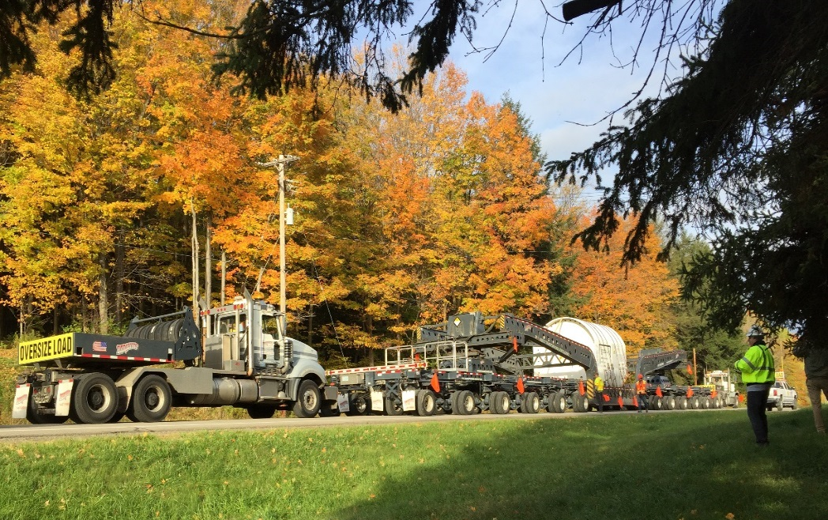
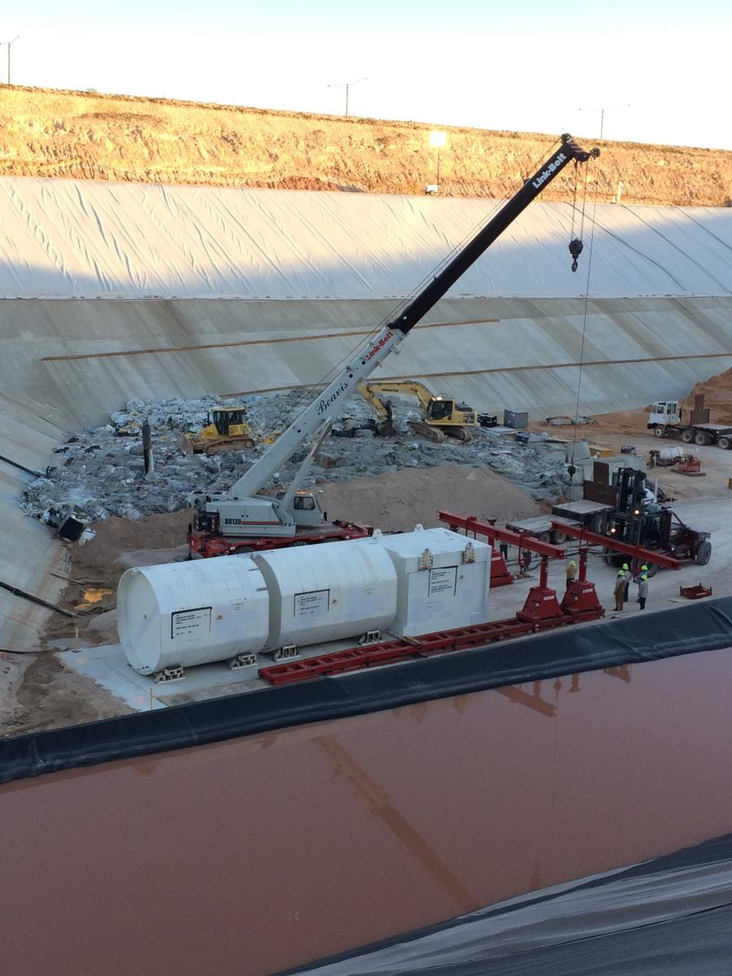
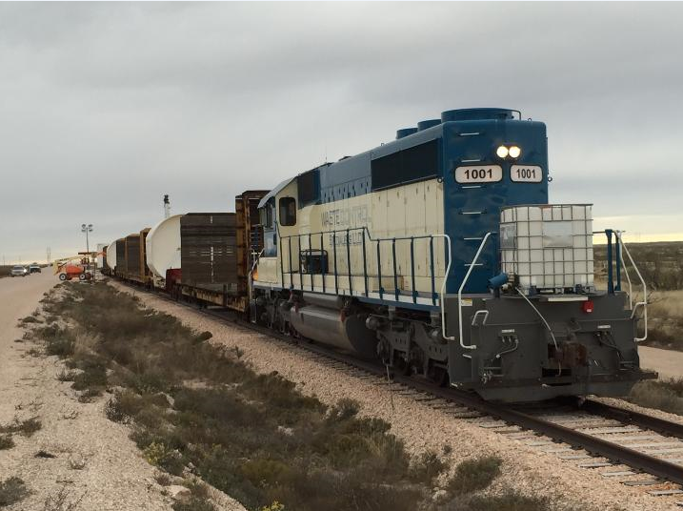
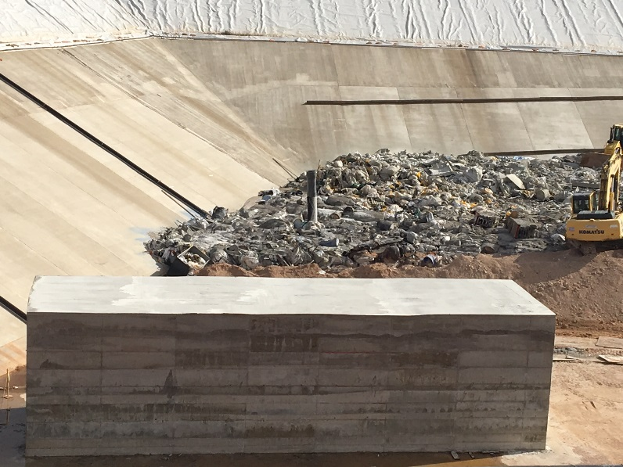
Disposition of West Valley Large Components

Slide 7
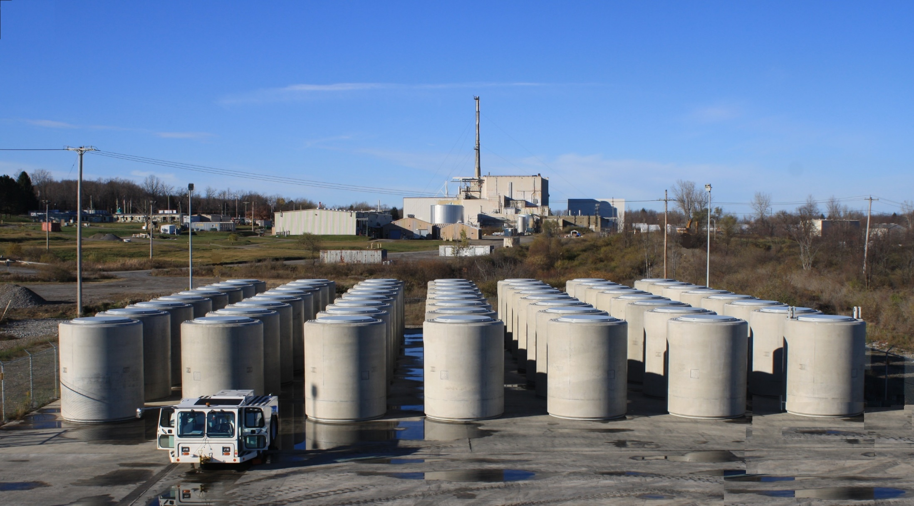
WVDP Relocated HLW

Slide 8
Complex-wide LLW/MLLW Disposal Rates by Disposal Location

Slide 9
Status on GTCC LLRW & GTCC-Like Waste Disposal
In February 2016, DOE published the Final Environmental Impact Statement for the Disposal of Greater-Than-Class C (GTCC) Low-Level Radioactive Waste and GTCC-Like Waste
GTCC LLW has radionuclide concentrations that exceed the limits for Class C LLW.
GTCC LLW currently does not have a defined disposal path.
GTCC-like waste is DOE owned or generated LLW or TRU waste with characteristics similar to GTCC LLW, and with no identified disposal path.
Preferred alternative: land disposal at generic commercial facilities and/or WIPP geologic repository.
The Final EIS has the potential to enable disposal of the entire GTCC LLW and GTCC-like waste inventory of approximately 12,000 cubic meters (m³).
Presently there is no preference among the three land disposal technologies (intermediate-depth borehole, enhanced near-surface trench, and above-grade vault) at generic commercial facilities.
In accordance with the Energy Policy Act of 2005, before the Secretary of Energy makes a final decision on the disposal alternative(s) to be implemented, a Report to Congress must be submitted.
The Report to Congress has been drafted and is in concurrence.

Slide 10
Status on GTCC LLW & GTCC-Like Waste Disposal Cont.
Submit Report to Congress
The Report to Congress will:
Describe alternatives under consideration
Identify waste volume, concentration, and other relevant characteristics
Identify the Federal and non-Federal options for disposal
Describe actions to ensure safe disposal of identified radioactive wastes
Describe projected costs
Identify options for ensuring that the beneficiaries of the activities resulting from the generation of GTCC waste bear all reasonable costs of disposing of such wastes
Identify statutory authority required for disposal of GTCC waste
Await Congressional Action
Issue Record of Decision

Slide 11
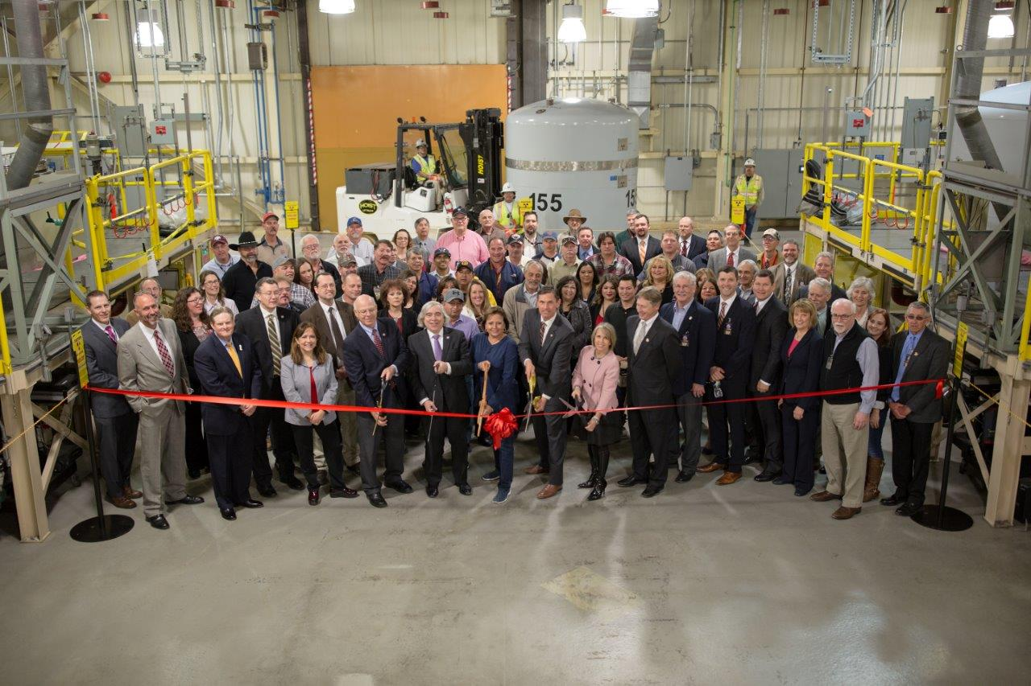
WIPP Update
WIPP Officially Reopened with a ribbon cutting ceremony held on January 9, 2017

Slide 12
WIPP Update: Look Ahead
Near-Term (next 12 months)
Waste emplacement operations in Panel 7
Shipping has resumed – establishing priorities
Supplemental Ventilation
Restart of mining operations
Continue preparation for closure of the far south end of the WIPP underground
Long-Term (1 to 5 years)
New - air intake shaft
New safety significant permanent ventilation system

Slide 13
WIPP Update: Projected Shipping Estimates
Key considerations in the development of the shipping estimate and points of origin included:
WIPP waste emplacement rate;
Available waste to ship;
Regulatory commitments and agreements;
WIPP transportation/waste acceptance capabilities; and
Flexibility for changing technical and policy constraints.
April 8th - TRU waste shipment from Idaho arrived at WIPP.
Site | Projected Shipments
Idaho | 61
Oak Ridge | 24
Savannah River | 8
Waste Control Specialists | 11
Los Alamos | 24
TOTAL | 128
April 13th - TRU waste shipment from SRS arrived at WIPP.

Slide 14
WIPP Update: Eligibility to Ship
In order to be eligible to ship waste for emplacement at WIPP, sites must verify that TRU waste meets the requirements for safe transportation and disposal:
All waste must meet requirements in the new WIPP Documented Safety Analysis, including chemical compatibility evaluations.
TRU generator sites are updating (and must get approval for) their TRU characterization, packaging and certification programs.
All previously certified waste must also be reviewed to verify that it meets the new Waste Acceptance Criteria.

Slide 15
Questions?

