Slide 1
Abandoned Cyclotrons and Decommissioning
Jennifer Opila
Colorado Radiation Program Manager

Slide 2
In the year 2000…
Notes:
In the year 2000 a company is licensed to operate this cyclotron in Denver for the purposes of producing radiopharaceuticals

Slide 3
Rough from the start
Competing with other large radiopharmaceutical companies in Denver
Between 2000-2009, company changes hands FOUR times, often through bankruptcy

Slide 4
What were we thinking? (part 1)
2011 CDPHE approves request to add 2nd cyclotron
Notes:
Used, In crates, at a location in a suburb of Denver
Research

Slide 5
Then things get bad- 2012
Lose contact with RSO and facility
Informed that licensee had filed for bankruptcy
Facility inspections
Location 1
Licensee no longer has access
Security not maintained
Location 2
Material still packed up and secure
Notes:
Licensee had not paid rent, could not be contacted. Building management took control and at the time of inspection was allowing access to maintenance crews. There was no current inventory. What are you supposed to have in your back pocket in these types of situations? A financial warranty!

Slide 6
What were we thinking? (part 2)
2002: $100,000
2003: $102,600
2007: $0
2010: $80,000
Notes:
2007 approved waiver to financial warranty
2010 approval when added second cyclotron: based on resale value of the cyclotrons

Slide 7
Bankruptcy is fun! (NOT)- 2013
CDPHE files action to be included in bankruptcy proceedings
Bankruptcy trustee has auction
CDPHE involvement
Very few assets liquidated
$10,000
Notes:
Can’t auction off radioactive materials
Items in restricted areas had to be released

Slide 8
Whose problem now?-2014
Landlords have possession and therefore are responsible
Potential buyer decides not to purchase cyclotron because it’s inoperable
Landlords can store in place or decommission
Location 1 decommissioning estimate is $200,000
CDPHE determines $80,000 will be split between the two landlords
MUST BE USED FOR DECOMMISSIONING
Notes:
Landlords not happy
Key components of the electronics for the cyclotron had disappeared

Slide 9
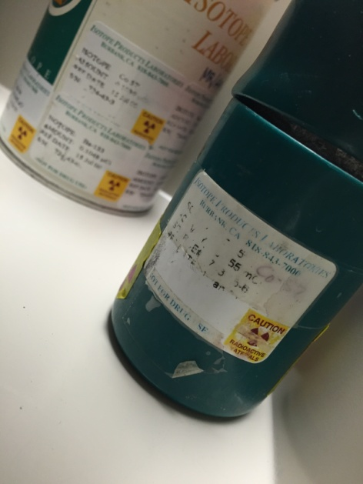
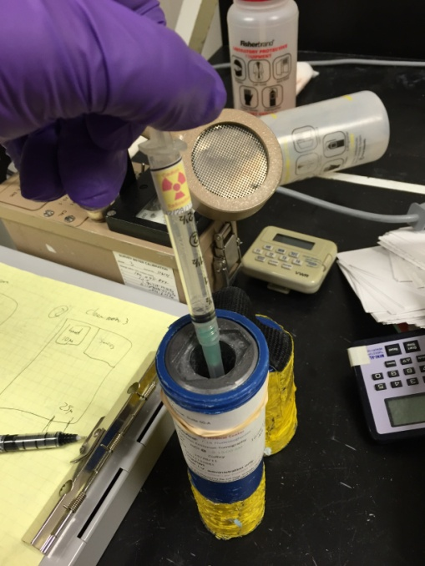
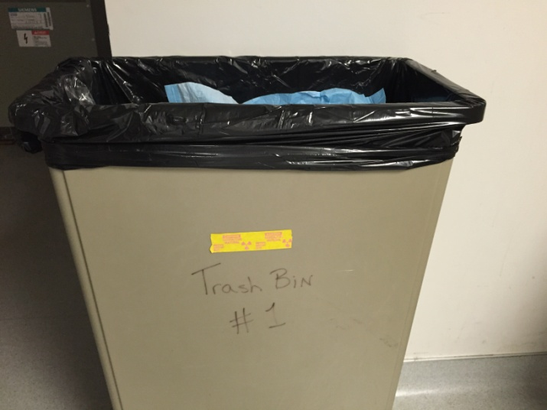
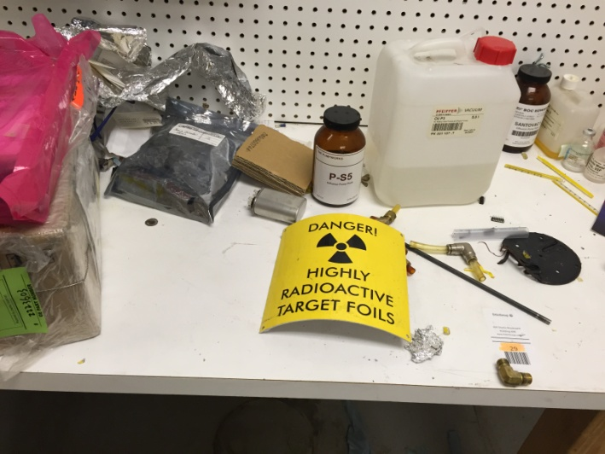
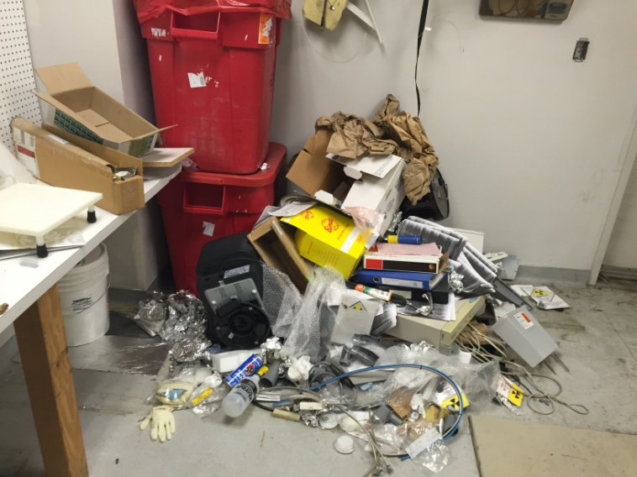
Things get worse- 2015
Notes:
Mess
Outside door unsecured

Slide 10
Things get better- 2015
Location 2-May 2015 decommissioning
Crates unloaded, materials surveyed
Materials removed
Facility free-released
Cost:$149,705
CDPHE reimbursement: $55,228

Slide 11
Things get better- 2015
Location 1- April-November 2015 decommissioning
Radioactive waste packaged and removed
Cyclotron dismantled and removed
Concrete samples of floors and walls analyzed for activation products
Facility free-released
Cost:$161,790
CDPHE reimbursement:$54,999

Slide 12
Success!- 2016
License terminated
March 2016

Slide 13
Lessons Learned
Cyclotron facilities require a warranty
Current facilities have $400,000-$450,000
Do not use “resale” value in warranty calculation
During bankruptcy situations, frequent site visits
YOUR GUT IS USUALLY RIGHT

Slide 14
Jennifer Opila, Colorado Radiation Program Manager
303-692-3403/jennifer.opila@state.co.us

