Slide 1
EPRI Research Key Tends in LLW Management & Research Perspectives on Part 61 Revision
Lisa Edwards Senior Program Manager
LLW Forum April, 2017
January 23, 2017

Slide 2
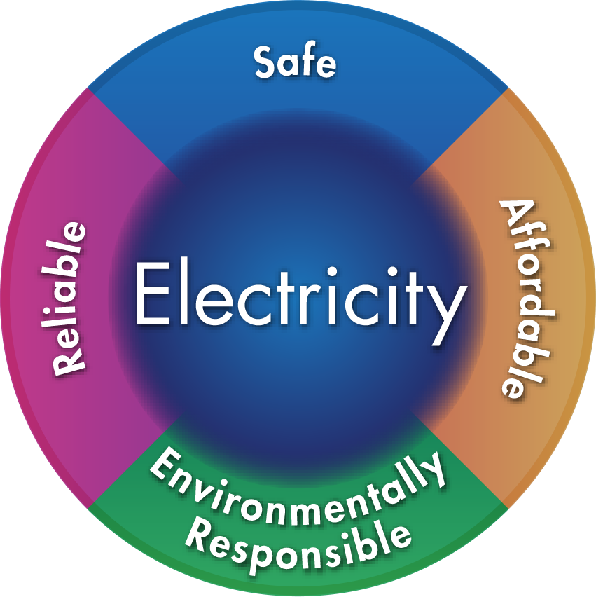
Together…Shaping the Future of Electricity
EPRI’s Mission
Advancing safe, reliable, affordable and environmentally responsible electricity for society through global collaboration, thought leadership and science & technology innovation
Independent, Collaborative, Nonprofit

Slide 3
US Generation Trend – Total DAW (lbs)
This graph includes both BWR and PWR data
Generated volumes of appear to have some scatter, but are generally near 120,000 lbs (54,431 kg) per year per unit
136,078 kg
9072 kg
Source: EPRI RadBenchTM

Slide 4
US Generation Trend – Total Wet Solid Waste (ft³)
This graph includes both BWR and PWR data
Generated volumes appear to be increasing
34 m³
Source: EPRI RadBenchTM

Slide 5
US Generation Trend – Class A Wet Solid Waste (ft³)
34 m³
This graph includes both BWR and PWR data
Generated volumes appear to be increasing
Source: EPRI RadBenchTM

Slide 6
US Generation Trend – Class B&C Wet Solid Waste (ft³)
This graph includes both BWR and PWR data
Generated volumes of Class B&C waste have been reduced in comparison to historic volumes, but are showing a slight increasing trend over the past 5 years
We will monitor to see impact of BTP Changes on these volumes going forward
Current average is approximately 125 ft³ (3.5 m³) per year per unit
6.8 m³
Source: EPRI RadBenchTM

Slide 7
US Generation Trend – PWR Class B&C Wet Solid Waste
Generated volumes of Class B&C waste have been reduced in comparison to historic volumes, but are fairly steady to slightly increasing over the past 5 years
We will monitor to see impact of BTP Changes on these volumes going forward
Current average is approximately 130 ft³ (3.7 m³) per year per PWR unit
5.7 m³
Source: EPRI RadBenchTM

Slide 8
US Generation 2015 – PWR Class B&C Wet Solid Waste
Average reported PWR generation of Class B & C waste reported in 2015 was 133 ft³ (3.8 m³) per year per unit
Range: 0-600 ft³ (0-17 m³) per year per unit
22.7 m³
600 ft³
280 ft³
150 ft³
30 ft³
Source: EPRI RadBenchTM

Slide 9
US Generation Trend – BWR Class B&C Wet Solid Waste
Generated volumes of Class B&C waste have been reduced in comparison to historic volumes, but increasing since 2009
We will monitor to see impact of BTP Changes on these volumes going forward
Current average is approximately 100 ft³ (2.8 m³) per year per BWR unit
8.5 m³
Source: EPRI RadBenchTM

Slide 10
US Generation 2015 – BWR Class B&C Wet Solid Waste
Average reported BWR generation of Class B & C waste reported in 2015 was 98 ft³ (2.8 m³) per year per unit
Range: 0-429 ft³ (0-12.1 m³) per year per unit
14.2 m³
429 ft³
70 - 100 ft³
0 ft³
Source: EPRI RadBenchTM

Slide 11
LLW Management Take-Aways
Data shows that there is reduction in the generation of Class B and C wet solid waste
Data also shows that there is a wide range of performance that indicates different practices
As practices become more uniform we may expect averages to decrease further
Implementation of the BTP 2015 is expected to further lower Class B and C generation rates
EPRI has contributed to the performance in this area with multiple reports
Notes:
3 points I would like to make today.
First EPRI research supports the site specific performance assessment approach. That is fairly well hashed out, so I won’t spend more time on it today.
Second, the limits in the classification table are dated on out dated science. The tables should either be removed or updated. As is, they are wrong and misleading.
Third, EPRI has done some base level research on developing the principle of low activity waste on a federal level. This work is not meant to provide the definitive solution – it is meant to start a conversation.

Slide 12
Part 61 Revision - 4 Points
1,000 year compliance period is adequate for the risk posed by waste generated from commercial nuclear power plants
For disposal sites have a more significant inventory of longer lived radionuclides
1,000 year compliance period should be retained
10,000 year period should be a protective assurance period
Classification Table limits are based on outdated science
Results in unwarranted emphasis on the wrong nuclides
Should be updated or deleted
The concept of Very Low Level Waste or Low Activity Waste should be addressed
Notes:
3 points I would like to make today.
First EPRI research supports the site specific performance assessment approach. That is fairly well hashed out, so I won’t spend more time on it today.
Second, the limits in the classification table are dated on out dated science. The tables should either be removed or updated. As is, they are wrong and misleading.
Third, EPRI has done some base level research on developing the principle of low activity waste on a federal level. This work is not meant to provide the definitive solution – it is meant to start a conversation.

Slide 13
1,000 Year Compliance Period
Average Concentration, Ci/m³
Graph based upon disposal records of nuclear power plant (NPP) wastes
EPRI research indicates that the majority of activity in Low-Level Radioactive Waste (LLRW) from NPP’s consists of radioisotopes that will decay to minimal levels within 300 years
The concentrations identified in this graph can be divided by the existing 10CFR61.55 concertation limits as a measure of risk

Slide 14
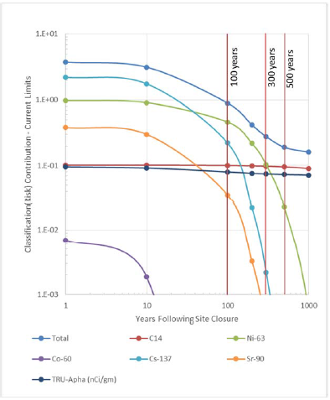
Assessment of Risk Over Time
Concentration / Classification Limit
For the first 300 years, disposal risk is driven almost entirely by ¹³⁷Cs and ⁶³Ni
After 500 years, only ¹⁴C and TRU continue to stand as risk contributors
Neither ¹⁴C or TRU in this mixture are ever more than about 10% of Class A limits
EPRI research indicates that the hazard represented by commercial NPP waste is well enveloped by the 1,000 year compliance period
Note that this analysis does not include depleted uranium

Slide 15
10,000 Year Period for Long Lived Waste
1,000 year compliance period should be retained
10,000 year period should be a protective assurance period
This would acknowledge the extremely high levels of uncertainty associated with such long time frames
The assumption of human activities and biology being the same as they are today helps to bound variables, but not address the uncertainty

Slide 16
Dose Conversion Factors in Waste Classification
10 CFR 61.55 Waste Classification Limits Established by analyses done for NUREG/CR-1759
Dose Conversion Factors Based on ICRP-2 (1959)
NRC Initiative to Become More ‘Risk Informed’
ICRP Has Made Updates to Dose Conversion Factors
ICRP 26/30 (1977)
ICRP 60/72 (1991)
What Kind of Changes to Waste Classification Can be Expected if DCF Changes are Applied to the Limits?
Notes:
So, the classification tables are based on dose conversion factors from ICRP 2 as in 1959.
These factors have been updated and EPRI looked at what the impact of the updated factors would be if only the DCF were updated and nothing was changed about the assumptions or the algorithm that used to dervive the classification limits

Slide 17
Changes to Waste Classification Tables
10 CFR 61.55 Table 1
Radionuclide | Value (Ci/m³) | New Value (Ci/m³)
C-14 | 8 | 2
C-14 in activated metal | 80 | 20
Ni-59 in activated metal | 220 | 3300
Nb-94 in activated metal | 0.2 | 0.29
Tc-99 | 3 | 0.14
I-129 | 0.08 | 0.024
Transuranics w/ T_{1/2} > 5 yr | 100 | 8.7
Pu-241 | 3500 | 500
Cm-242 | 20000 | 21000
10 CFR 61.55 Table 2
Radionuclide | Value (Ci/m³) |  |  | New Value (Ci/m³)
 | Class A | Class B | Class C | Class A | Class B | Class C
T_{1/2} < 5 yr | 700 | * | * | NC | * | *
H-3 | 40 | * | * | 65 | * | *
Co-60 | 700 | * | * | 1000 | * | *
Ni-63 | 3.5 | 70 | 700 | 24 | 490 | 4900
Ni-63 in activated metal | 35 | 700 | 7000 | 240 | 4900 | 49000
Sr-90 | 0.4 | 150 | 7000 | 3.5 | 1300 | 61000
Cs-137 | 1 | 44 | 4600 | 1.5 | 65 | 7100
Current dominant waste class controlling nuclides
Some limits increase, some decrease, but current limits focus on wrong nuclides
Notes:
The report that is publically available, summarizes the work with what the new classification tables might look like if the they were updated to reflect the DCF impacts.

Slide 18
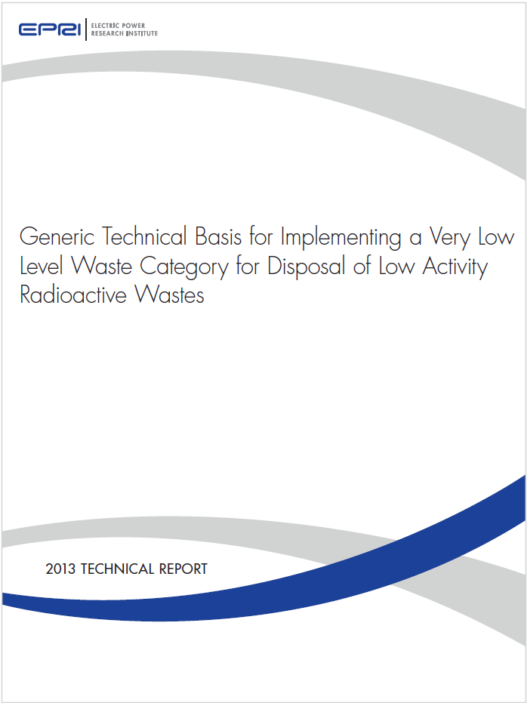
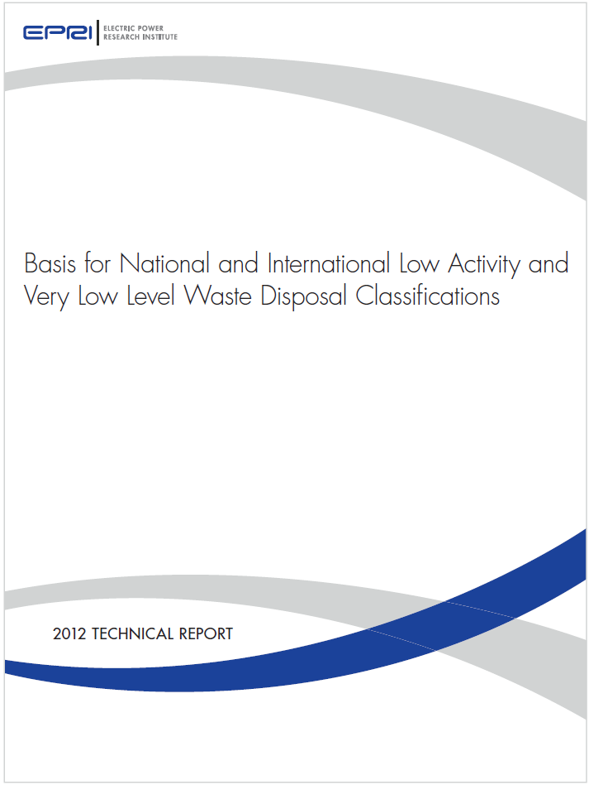
EPRI Research Regarding VLLW
2 publically available reports
Investigation conclusions:
Safe, practical and practiced in the US and abroad
Significant industry O&M and decommissioning savings can be realized with RCRA VLLW disposal path
Project provides valuable technical input to the process of risk informing 10 CFR Part 61
We should start a conversation
3002000587
1024844
Notes:
Finally,
The concept of VLLW.
EPRI has published 2 reports on the topic and encourages this audience and the NRC to sue them to start a conversation about establishing a federal standard for VLLW as a separate waste classification.

Slide 19
VLLW Cost Savings Projection EPRI Report: 1024844
~$6 Billion Gap NPV
Notes:
As the decommissioning of the fleet approaches, this change could have large financial impacts to generators and also be a way to conserve precious LLW Disposal capacity. The time to have this conversation is now before the need is great and to allow ample time for any legislation that may be required.

Slide 20
Associated EPRI Reports (Reference)
3002008189 Implementation Guidance for the Nuclear Regulatory Commission Branch Technical Position on Concentration Averaging and Encapsulation, Rev. 1
3002003121 Dose Conversion Factor Evaluation and IMPACTS Analysis of Low Level Radioactive Waste
3002000587 A Generic Technical Basis for Implementing a Very Low Level Waste Category for Disposal of Low Activity Radioactive Wastes
1026575 EPRI Global LLW Profile – Generation, Treatment, Conditioning, and Disposition
1025304 Technical Basis to Risk Inform 10CFR61: 2012 Update
1025302 Additional Research Supporting Changes to the Branch Technical Position: Summary of EPRI Input to the Process
1024844 Basis for National and International Low Activity And Very Low Activity Low Level Waste Disposal Classifications
1021098 Options for Improved Low Level Waste Disposal Using 10CFR61.58
1019222 Developing Alternative Low Level Waste Disposal Criteria Per 1-CFR61.58
1016761 Proposed Modification to the NRC Branch Technical Position on Concentration Averaging and Encapsulation
1016120 An Evaluation of Alternative Classification Methods for Routine Low Level Waste from the Nuclear Power Industry
1013506 Technical Development of New Low Level Waste Disposal Options: Industry Strategic Database
1013585 Preliminary Investigation of Alternatives to the Current Disposal Criteria
1009905 Development of New LLW Disposal Options: Phase 1 Interim Report of the EPRI Industry Strategic Database

Slide 21
Associated EPRI Reports (Reference)
1023017 Waste Class B/C Reduction Guide Revision 1
1015115 Waste Class B/C Reduction Guide
1014707 Operational Strategies to Reduce Class B/C Wastes
1011727 Radioactive Wet Waste Reduction Opportunities for Waste Class B and Class C

Slide 22
Together…Shaping the Future of Electricity

