Slide 1
Approaches and Tools to Improve Decision Making for Low-Level Radioactive Waste Disposal
Paul Black, PhD
Neptune and Company, Inc.
www.neptuneinc.org
And many others at Neptune
LLWForum Spring 2017
Denver, CO

Slide 2
Quick Decisions
Notes:
Values – time, cost
Probability – not getting caught in time

Slide 3
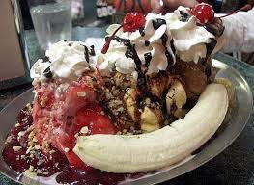
Quick Decisions
Notes:
Values – yum (taste), cost, impact on digestive system
Probability – of negative impact

Slide 4
Quick Decisions
Notes:
Values – emotional
Probability – of success (maybe as long term or short term?)
Values can outweigh probabilities in a decision analysis – that’s fine, but separate them.

Slide 5
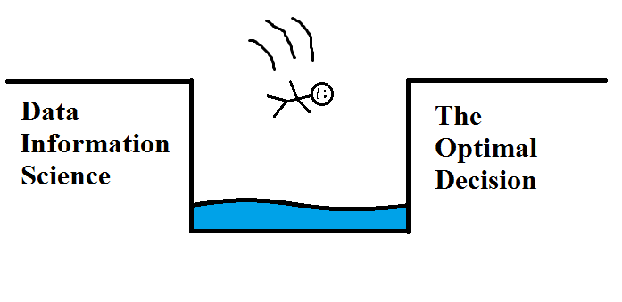
Unsupported Decisions

Slide 6
Cognizant Decisions
Notes:
Better data
Options – consider multitude of options
Values – speed/acceleration, safety, color, gas mileage, child safety, etc.
Probability – of safety, of gas mileage, of child safety, etc. – these days this can be data driven with uncertainty

Slide 7
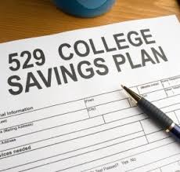
Cognizant Decisions
Notes:
Same idea
Values – costs, benefit of supporting child going to College
Probability – performance of funds, will child go to College?
Again data driven with uncertainty.

Slide 8
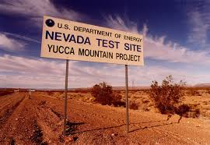
Cognizant Decisions
Notes:
Same thing – lots of data to support decision making
Options – how to best engineer the system and whether the system is beneficial vs alternative of not building YM (could consider other options – such as elsewhere)
Values – costs, human health risk, jobs, effect on local economy, upstream to effect on nuclear industry, etc.
Probability – human health risk, contaminant transport supported, all with much uncertainty

Slide 9
Cognizant Decision Making

Slide 10
Outline
What is risk?
What is Stakeholder Engaged Structured Decision Making (SE-SDM)?
What are the benefits of this paradigm?
Tools
Where is there interest now?

Slide 11
What is “Risk”?
Wikipedia (clearly an authoritative source!)
Risk is the potential (probability) of gaining or losing something of value.
Values (such as physical health, social status, emotional well-being or financial wealth) can be gained or lost when taking risk resulting from a given action or inaction, foreseen or unforeseen.
Uncertainty is a potential, unpredictable, and uncontrollable outcome.

Slide 12
Value/Probability Conundrum
“Unless we make a conscious choice to separate utility and probability, the two inevitably become intertwined in a hopeless melange in which we lose site of, and confuse, the underlying assumptions that drive our perceptions of what we want (utility) and what we’ll get (probability).”
Morgan D. Jones – The Thinker’s Toolkit (2009)

Slide 13
Conundrum Example
Betting on favorite team!
“If you’re honestly going to try and make money, you have to remain unbiased in every way. When you bet on your team, a large percentage of the time your judgment is clouded.”
Mixing utility (desire, preference) with probability (chance, uncertainty)

Slide 14
LLW Disposal Modeling
In LLW Waste Management we do not remain unbiased in our science modeling
We insert desire to be protective
That is, we insert conservatism
Consequence is that we are “losing our bets” (increased cost, not optimizing use of disposal system, not supporting nuclear industries, etc.)
And, we are expressing value judgments properly (arbitrary and ours instead of representing all stakeholders values)

Slide 15
What is Structured Decision Making?
“Formalized common sense”
A set of tools for structuring and analyzing complex decision problems
An approach for making logical, reproducible, and defensible decisions in the face of:
Technical complexity
Uncertainty
Costs and value judgments
Multiple, competing objectives
Based on the tested theory of decision analysis
Notes:
Basics of DA

Slide 16
Decision Analysis Results
In the long run, it is best to choose the alternative (decision option) that provides the best expected outcome, given what you know or believe about future events.
Aim to Maximize expected societal welfare
Also – Risk management, Cost-benefit analysis, Options analysis, MCDA, Economic analysis….
Notes:
Get the point across that this is an economic argument supported by the 3 pillars of sustainability, not just one but 3.

Slide 17
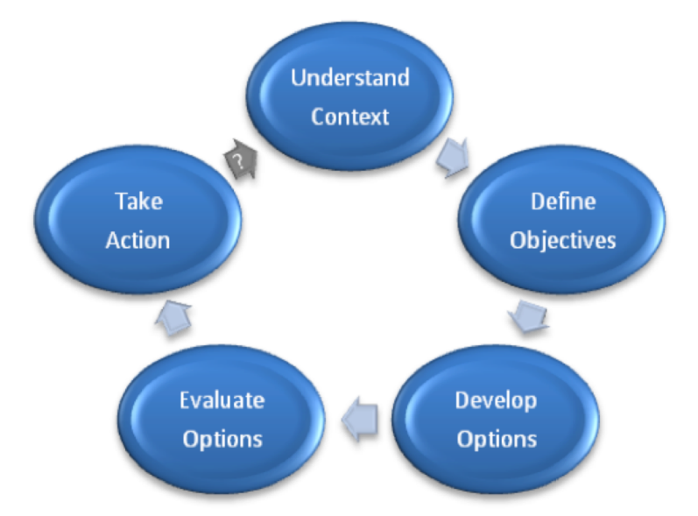
Structured Decision Making
1. Site, problem, regulations, stakeholders
5. Adaptive management as more data are collected
2. Values – costs, risk, safety, economy, jobs
Iterate
3. Options from stakeholders and SMEs
4. Uncertainty, sensitivity
Notes:
Formalized Common Sense
Modern DQOs?
Neptune personnel developed the DQO process – aimed at understanding context, boundaries, etc., but limited to evaluation of 2 options, simple statistical models, and very limited value functions. SDM opens the door to a lot more.

Slide 18
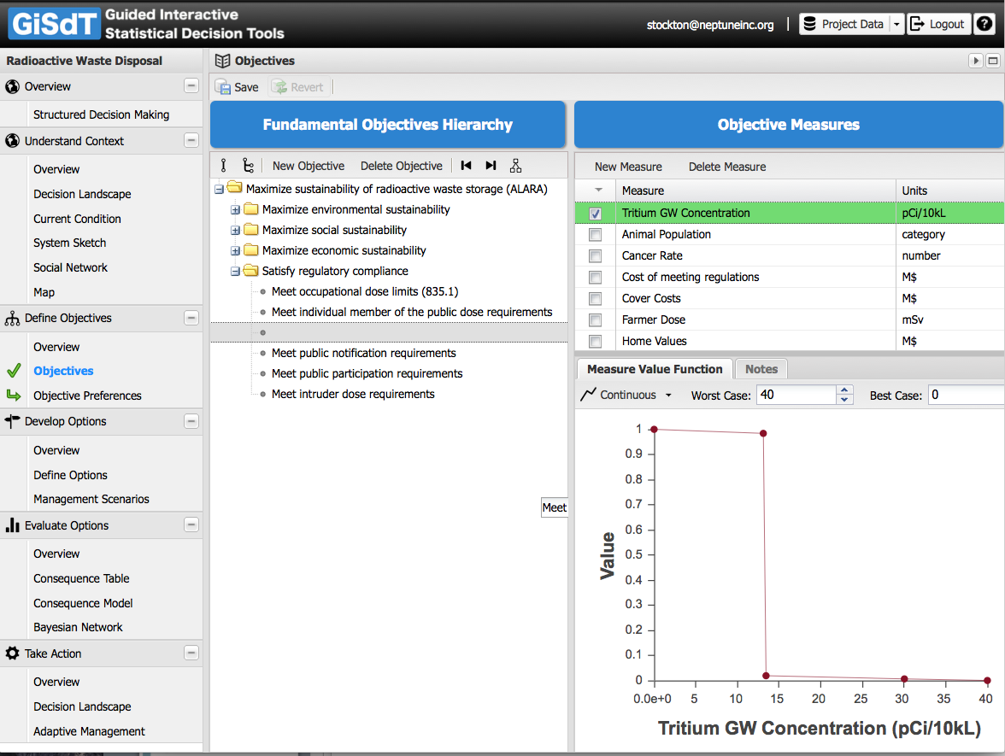

Slide 19
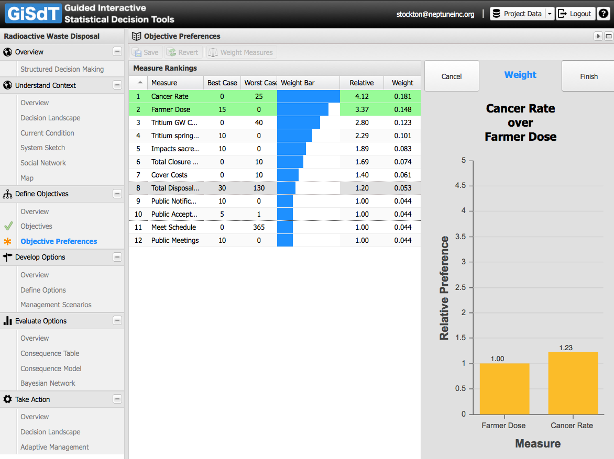

Slide 20
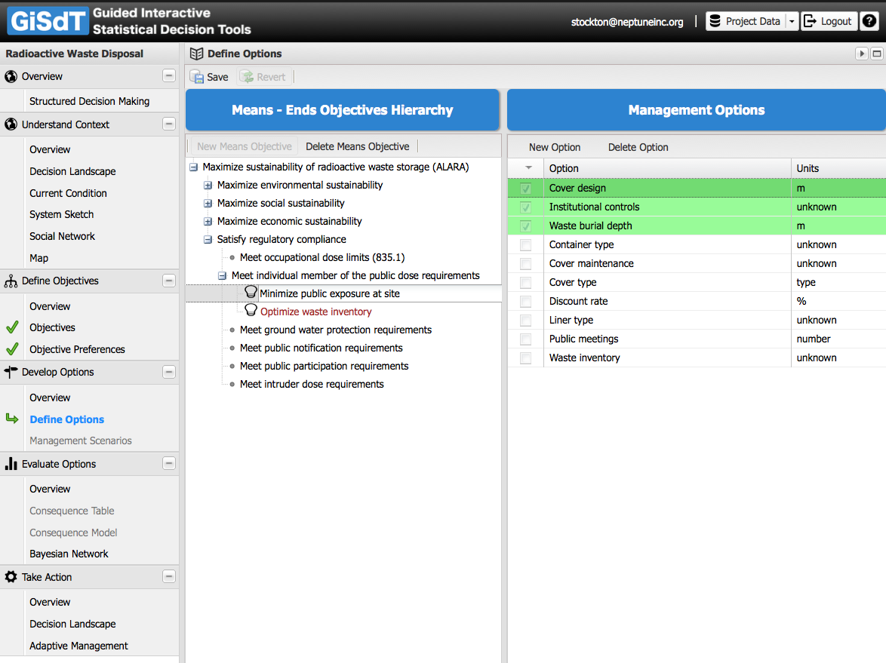

Slide 21
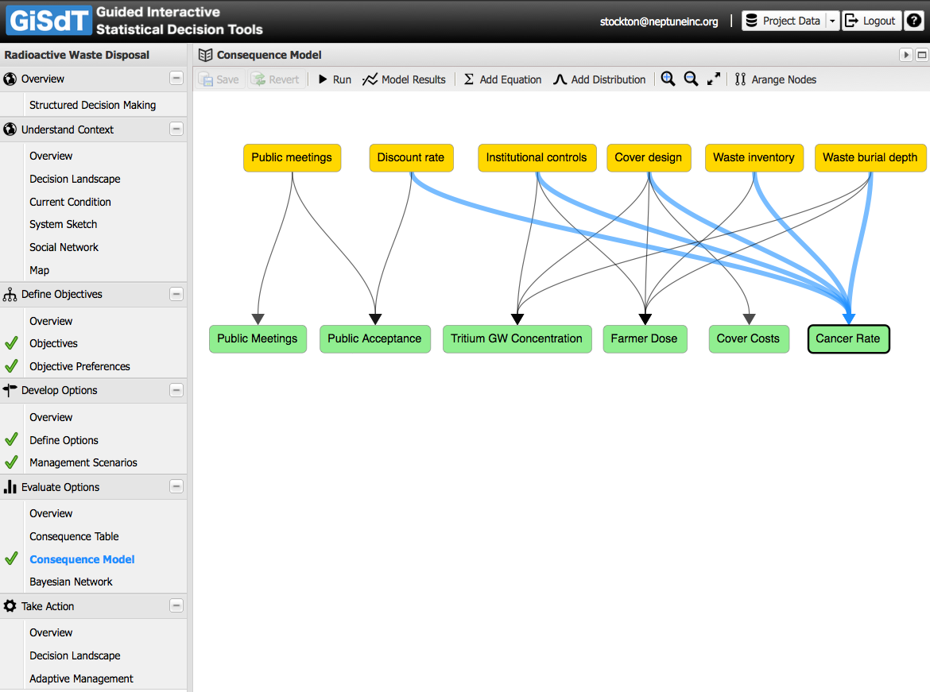

Slide 22
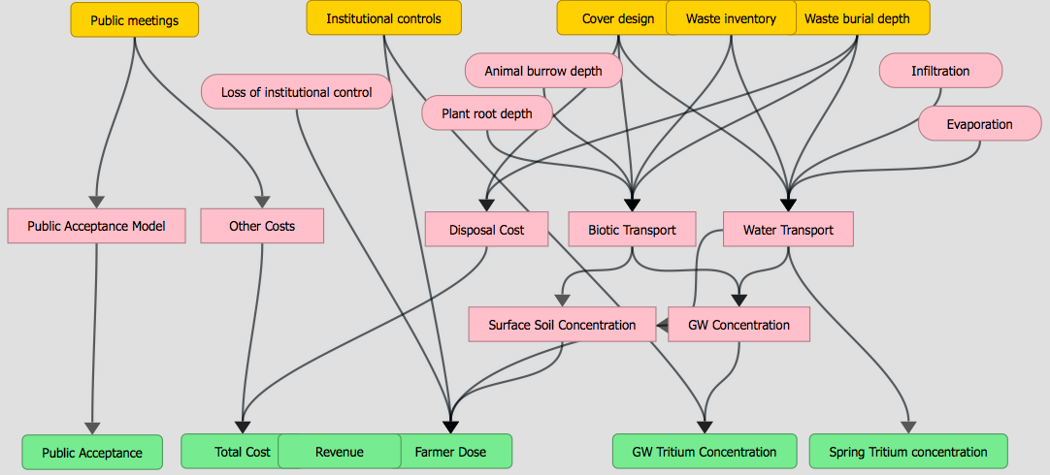
Options ➔ Models ➔ Objectives

Slide 23
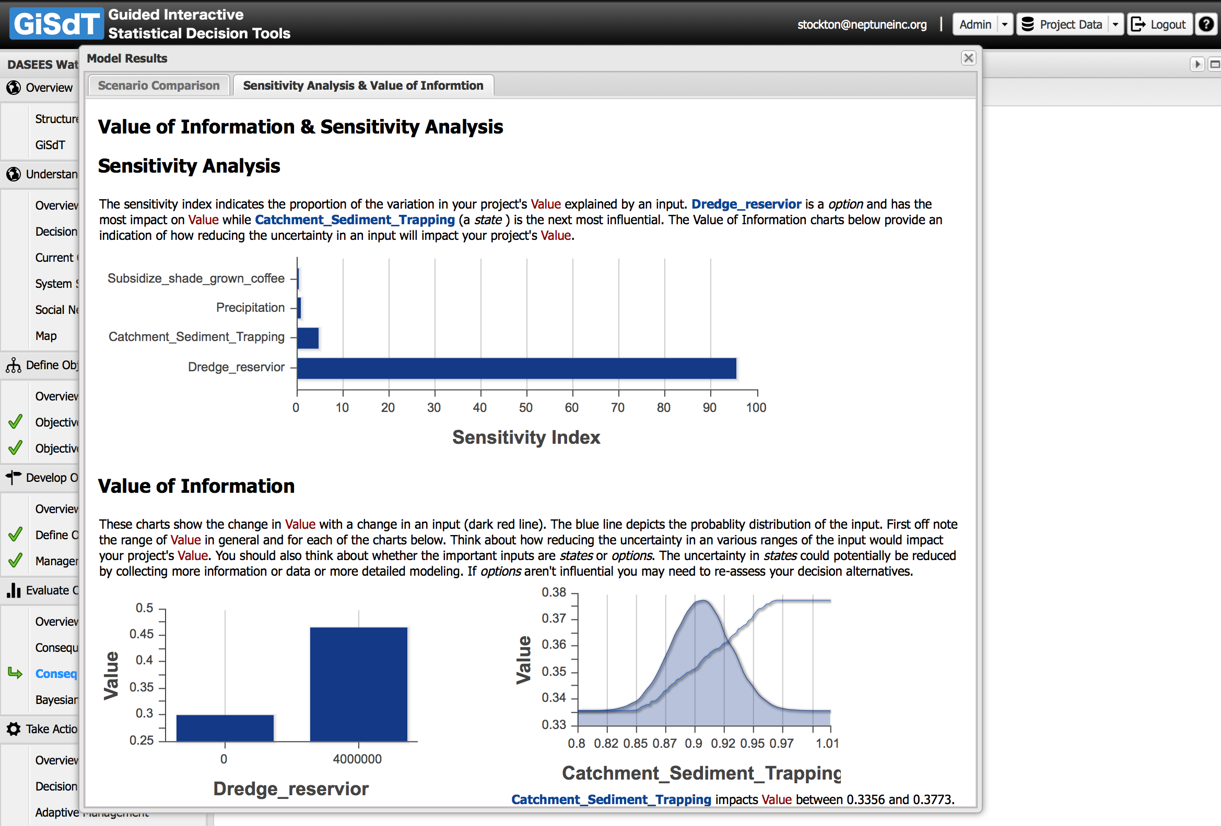

Slide 24
Benefits of SE-SDM
Defensibility, traceability, transparency, reproducibility, openness, vetting, agreement, etc.
This means we can better support our nuclear industry (level the playing field?)
Bring down costs while still being protective
Address some of GAO’s concerns?
And some Congressional concerns?
Optimize:
disposal (so we don’t run out of space sooner than necessary)
remediation
decommissioning

Slide 25
Benefits of SE-SDM
Easier to understand
Easier to communicate and explain
Because it represents what we think we know and our uncertainties about that
I.e., it’s honest
Rather than what we know to be wrong, inaccurate, or mis-applied
Consequently, more difficult to disagree
Helps avoid redo, or another stone
Notes:
Argue this case. Too often we hear that simplistic deterministic models are easy to explain. Well, not to me, and not in my experience

Slide 26
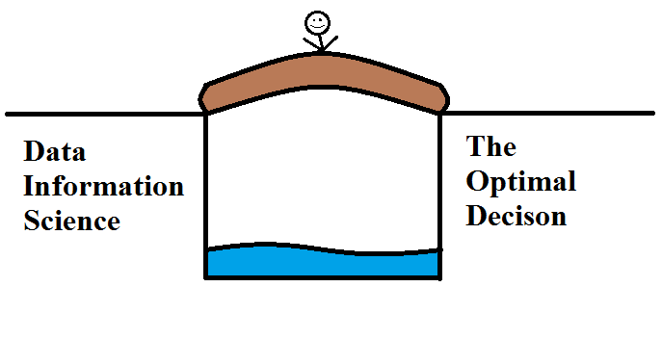
Structured Decision Making
SDM builds a bridge to Optimal, Defensible, Transparent Decision Making

Slide 27
Current Interest?
Home:
EPA, FDA, UAF
DOE
P&RA COP, EFCOG
GAO?
Abroad:
IAEA initiative – CIDER
OECD-NEA
http://www.oecd-nea.org/news/2017/2017-01.html
Notes:
EPA – brownfields, regional planning, watershed mgmt, coral reef mgmt, resiliency planning (sea level rise), superfund, farming/ranching optimize management and practice
FDA – food safety
UAF – organizational planning
DOE – PA-related, environmental monitoring optimization, remediation options – now doing decommissioning and remediation
EFCOG – Best Practice on SE-SDM
GAO – General interest in cost savings while being protective
IAEA – CIDER initiative SE-SDM – MODARIA initiative – SDM
OECD-NEA – general interest in the same subject (Christophe Xerri, Magwood, Gurria)

Slide 28
Current DOE Projects
West Valley
Options analysis for long term disposition of various types/sources of radioactive material/contamination
Exhumation vs Engineering
Los Alamos
Options analysis for the long term disposition of RH TRU in 33 shafts
Exhumation vs Engineering

Slide 29
Current DOE Projects
Exhumation
Partial or full?
Reprocessing, packaging, shipping (where?)
Engineering
Covers, walls
Time frames
Both systems will fail without engineering, so this is a race against time itself
Regulatory paradigm includes DOE Orders, NRC (WV), EPA, States, and NEPA

Slide 30
GAO potential interest?
GAO Report to Congressional Committees. High-risk Series. February 2017.
The GAO estimated the US Government’s environmental liabilities at $447B in FY16, $372B (83% of $447B) borne by DOE alone
And the liability is perhaps somewhat under-stated (FISA rules regarding inestimable liabilities)
DOE estimated a decrease based on benefits of technology development and that ARRA funding
GAO is interested in ways to reduce DOE’s environmental liability

Slide 31
CIDER II – An IAEA Initiative
Constraints to Implementing Decommissioning and Environmental Remediation Strategies – Phase II
Addressing Member States with legacy nuclear/radioactive contamination issues
Aim of CIDER – Improve current levels of performance on D&ER across the Member States
CIDER II goals – action oriented to:
Improve stakeholder communication and engagement
Help MS establish and implement strategies for D&ER
Support capacity building in the MS

Slide 32
Onwards and Upwards?
Interest in SE-SDM continues to expand
It meets with success wherever it is used
It provides
Technical defensibility
Reproducibility (of decisions)
Traceability
Transparency
And avoids redo because the stakeholders are part of the process
SE-SDM helps bring effective/successful decision making across the finish line.

Slide 34
Stakeholder Engaged – SDM
Values-focused thinking (Ralph Keeney, 1990s)
What matters to the stakeholders (why)
Concerns (values) lead to identification of objectives (e.g., reduce risk, minimize costs, improve local economy, sustain economy, protect environment, etc.)
Objectives (what) lead to initial options (how)
Options augmented by subject matter experts
Consequence analysis (probability/uncertainty) performed by SMEs (evaluate options by connecting to and estimating effect on objectives – address uncertainties throughout)
Dialogue/iterate
Adaptive management

Slide 35
SDM References
Structured Decision Making: A Practical Guide to Environmental Management Choices
Robin Gregory, Lee Failing, Michael Harstone, Graham Long, Tim McDaniels, Dan Ohlson – Wiley, March 2012
Value-Focused Thinking: A Path to Creative Decision Making.
Ralph Keeney – Harvard University Press, 1992
“Values are what we fundamentally care about in decision making. Alternatives are simply means to obtain our values”.

Slide 36
Benefits of SE-SDM
Defensibility, traceability, transparency, reproducibility, openness, vetting, agreement, etc.
Mitigates against decision making bias (improves decision making and reduces costs)
Provides clarity on wider question of value (rather than just costs)
Transparency improves societal support and benefits local socio-economic planning
Provides greater certainty and confidence (more reliable lifetime planning and cost estimation)
Provides reassurance that investments are both responsible and accountable to wider society
Supports more effective regulatory decision making

Slide 37
Confirmation? January OECD-NEA meeting
“STAKEHOLDER SUPPORT AND INVOLVEMENT IS ESSENTIAL TO FUTURE OF NUCLEAR ENERGY DECISION MAKING”
http://www.oecd-nea.org/news/2017/2017-01.html
Recognition of the same issues regarding the importance of SE in the decision making process

Slide 38
January OECD-NEA meeting
Mr Gurría (OECD Secretary‑General) noted that the quality of public involvement in the decision-making process may be as important as the quality of the scientific analysis or the engineering work needed to implement the decision.
He also stressed that "taking the shorter route and bypassing serious public engagement risks reaching decisions that will not stand the test of time as stakeholders continue to question the decision after it has been made. In the end, this path would cost much more, take much longer and also damage the credibility of decision makers in the process.”

Slide 39
January OECD-NEA meeting
Mr Magwood (NEA Director‑General) recalled that
"As we have learned through hard experience in many countries, experts cannot act alone to solve difficult problems.
For the greatest challenges facing society today, they must, as a central component of their activities, ensure the broad and deep support of public stakeholders.
This is important in all long-term, complex undertakings, but for decisions concerning nuclear energy that employ large tracts of land, use significant quantities of resources, and sometimes generate public questions about safety, achieving a durable public consensus has become an absolute requirement.”

